Slide 1
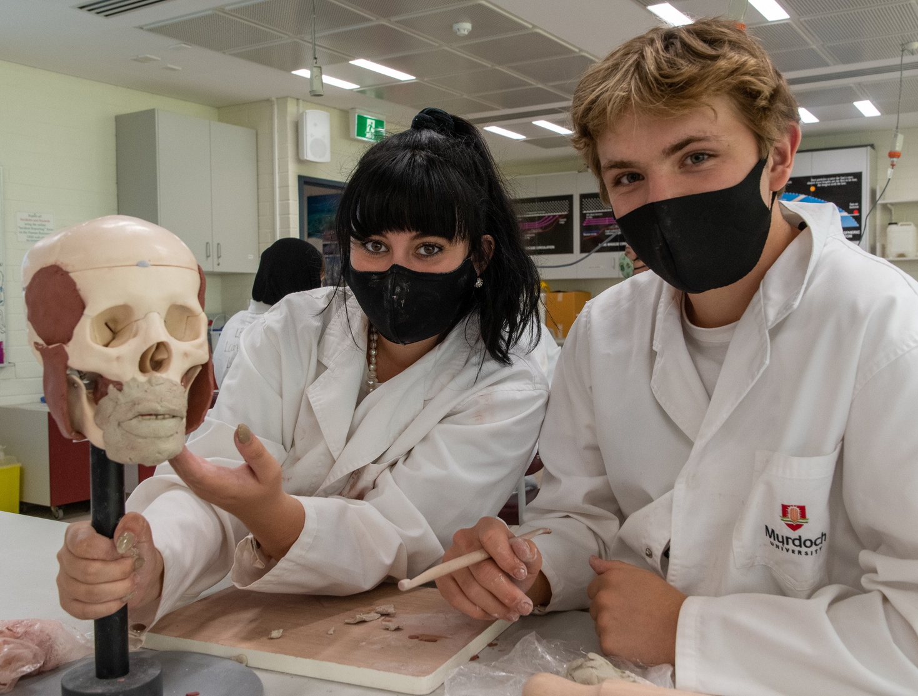
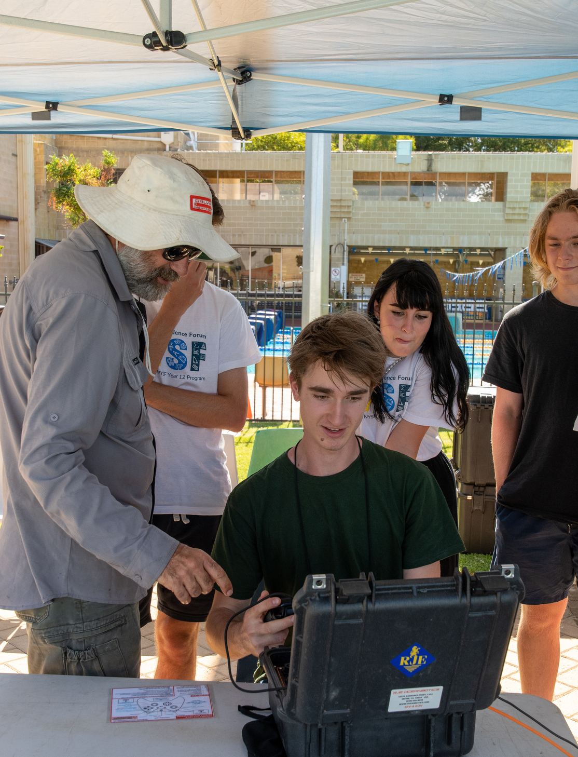
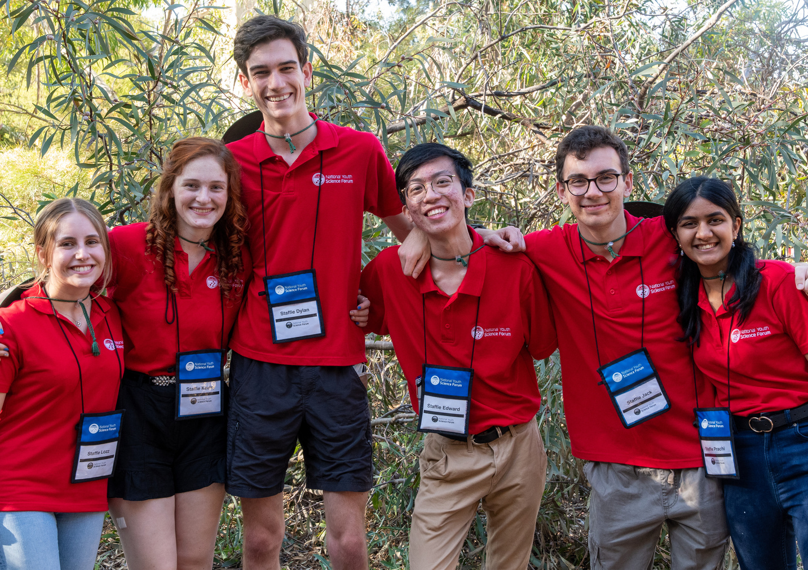
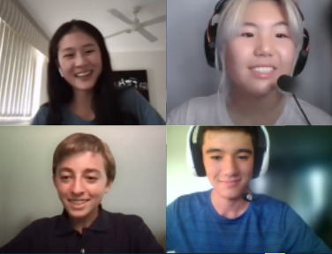
NATIONAL
YOUTH
SCIENCE
FORUM
STEM EXPERIENCE FOR CURRENT YEAR 11 STUDENTS
DIGITAL AND IN PERSON EVENTS
STEM LAB VISITS
SPECIALIST LECTURES
EXPERT WORKSHOPS AND
MASTERCLASSES
SOCIAL EVENTS WITH FELLOW
STEM ENTHUSIASTS
www.nysf.edu.au

Slide 2
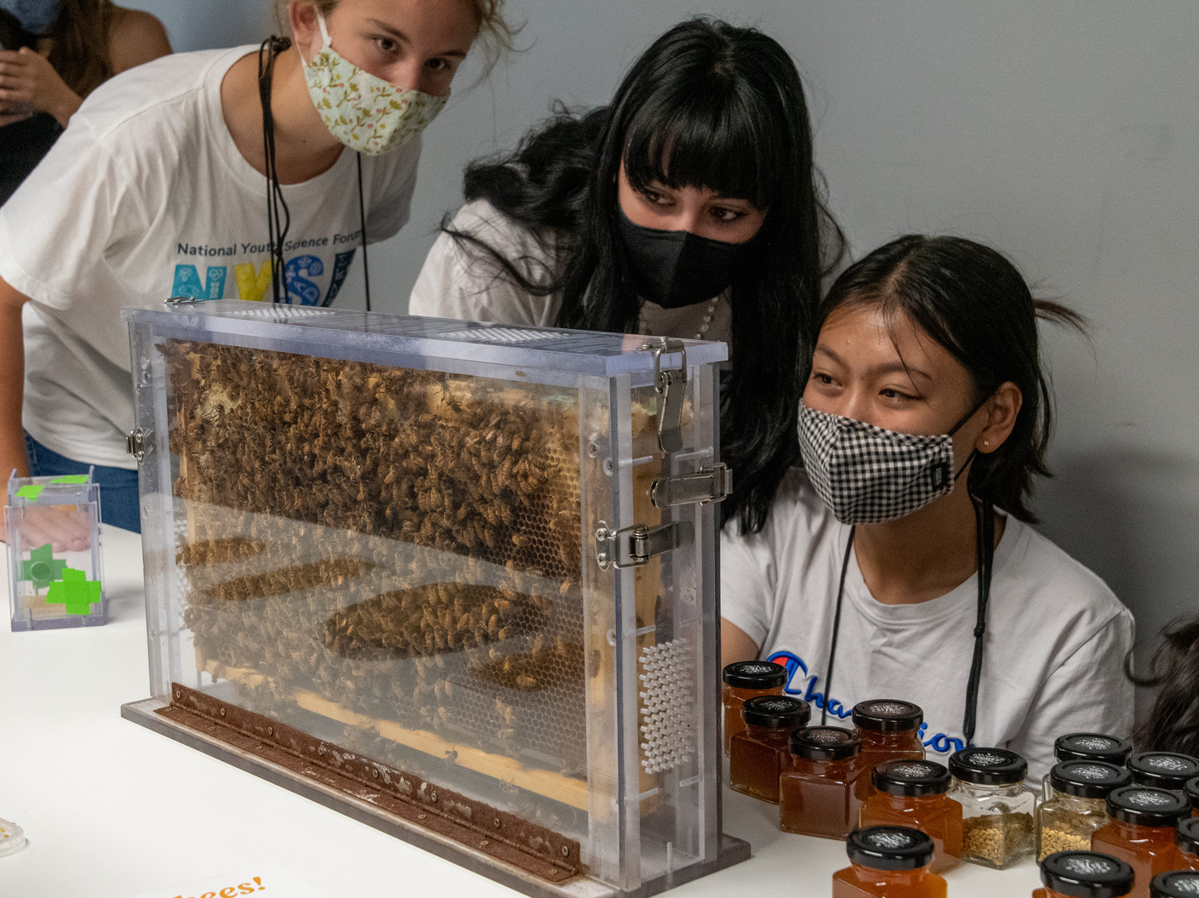
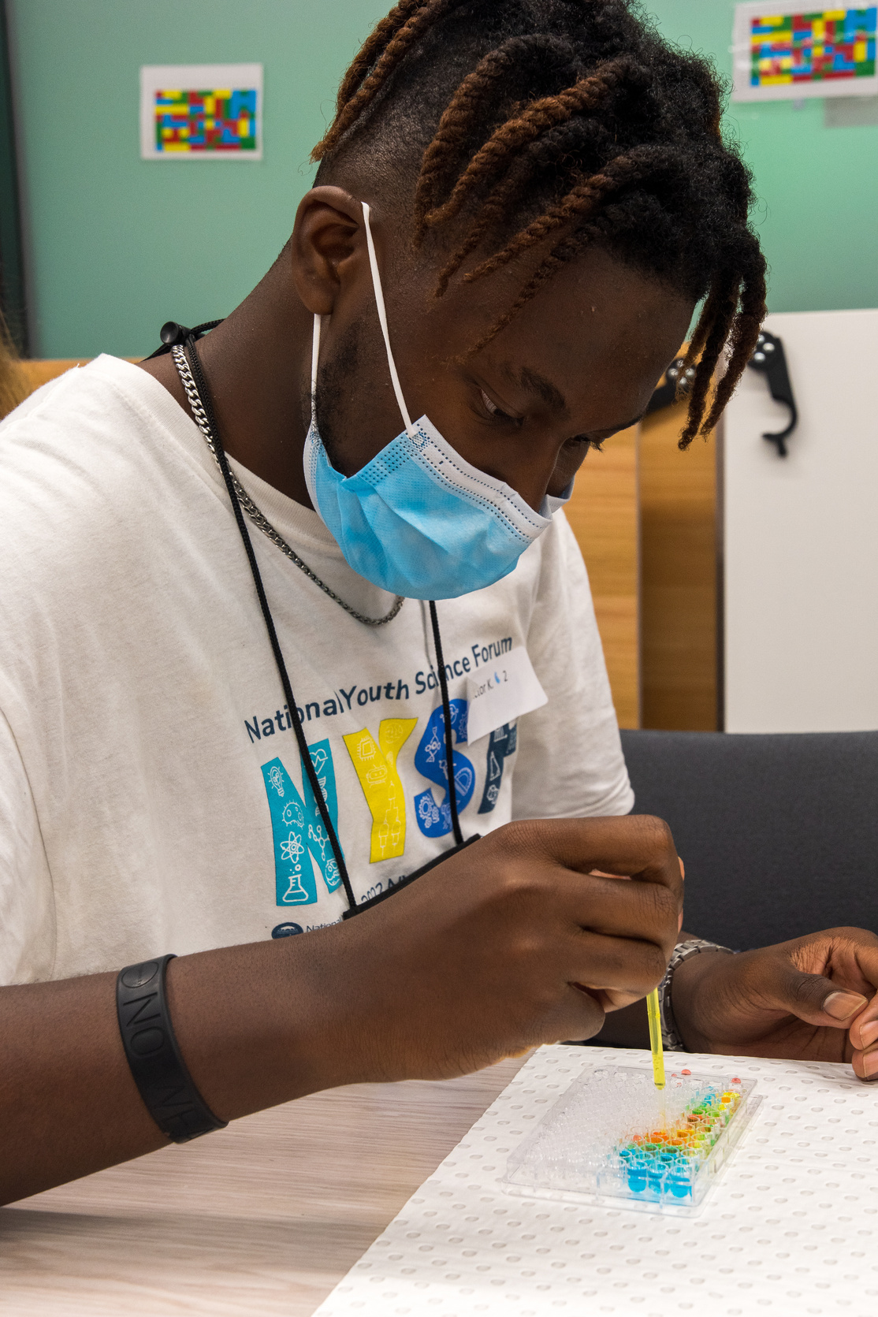
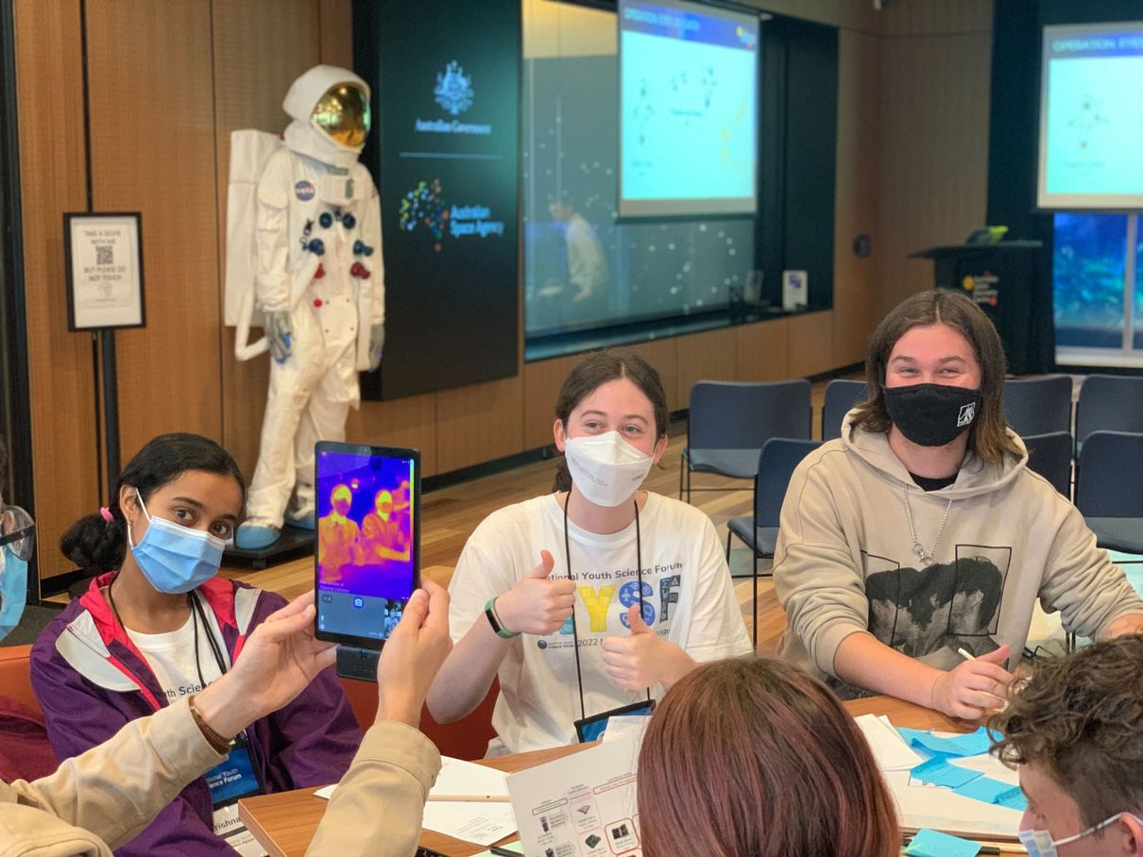
NATIONAL
YOUTH
SCIENCE
FORUM
STEM EXPERIENCE FOR CURRENT YEAR 11 STUDENTS
DIGITAL AND IN PERSON EVENTS
STEM LAB VISITS
SPECIALIST LECTURES
EXPERT WORKSHOPS AND
MASTERCLASSES
SOCIAL EVENTS WITH FELLOW
STEM ENTHUSIASTS
www.nysf.edu.au

Slide 3
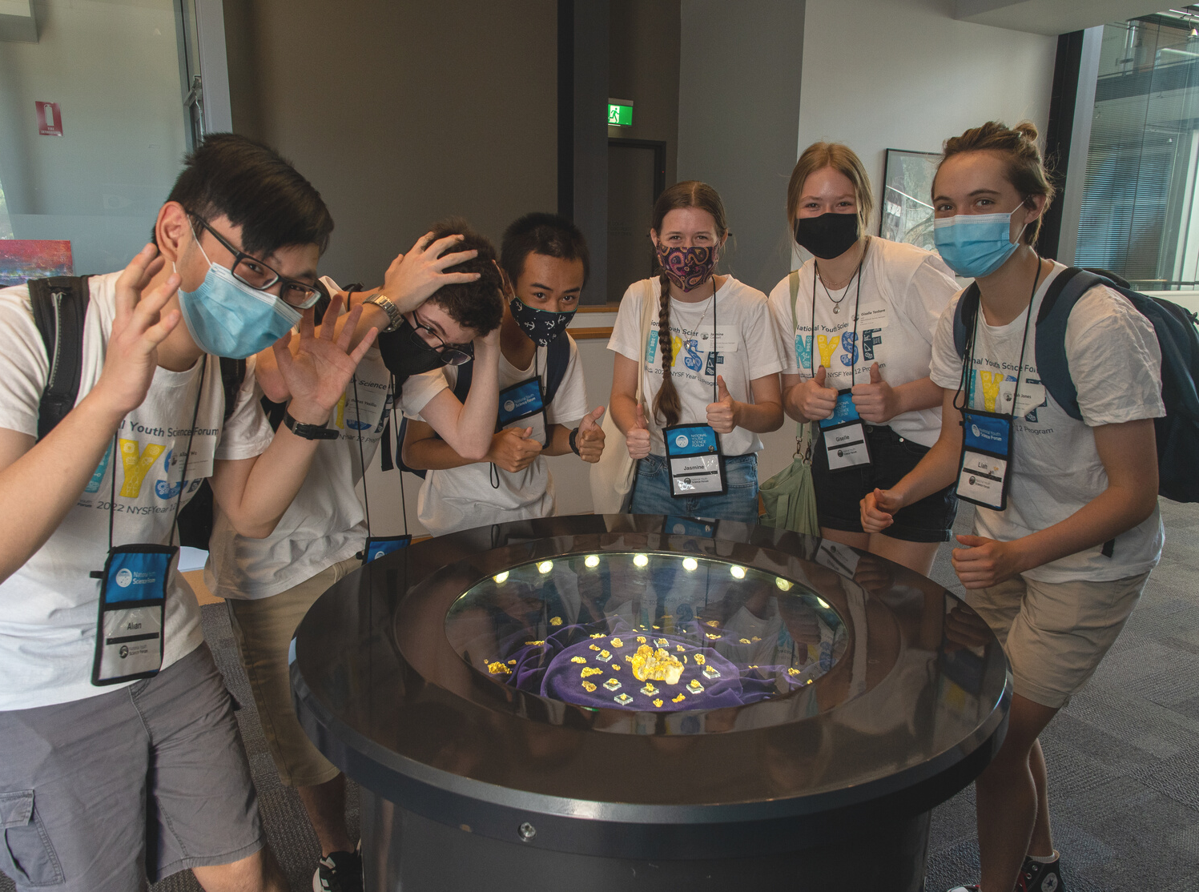
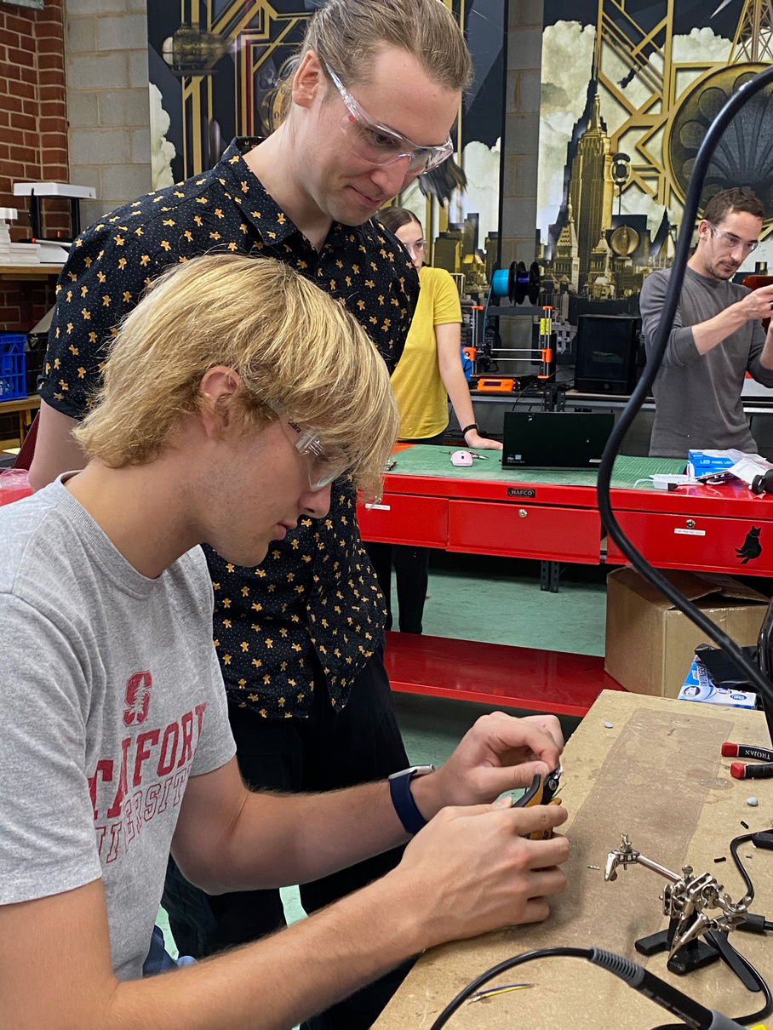
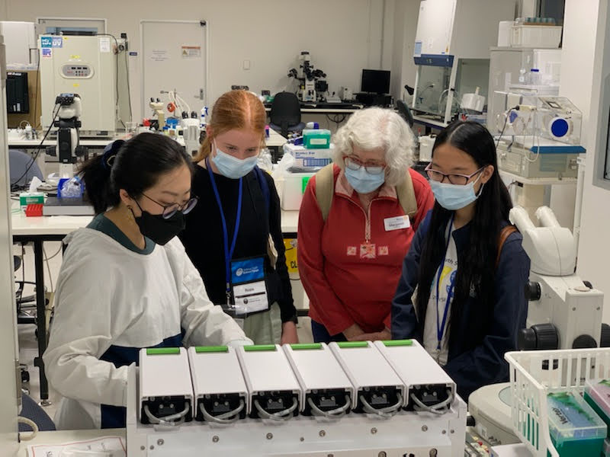
NATIONAL
YOUTH
SCIENCE
FORUM
STEM EXPERIENCE FOR CURRENT YEAR 11 STUDENTS
DIGITAL AND IN PERSON EVENTS
STEM LAB VISITS
SPECIALIST LECTURES
EXPERT WORKSHOPS AND
MASTERCLASSES
SOCIAL EVENTS WITH FELLOW
STEM ENTHUSIASTS
www.nysf.edu.au

