Slide 1
National Youth Science Forum
Template presentation
This template is designed to make your presentations about the NYSF a little bit easier.
Please use these slides as a base and add your own photos, stories & comments as you go!
Ensure you read the notes sections of each slide for more ideas. (Delete this slide before you make your presentation!)

Slide 2
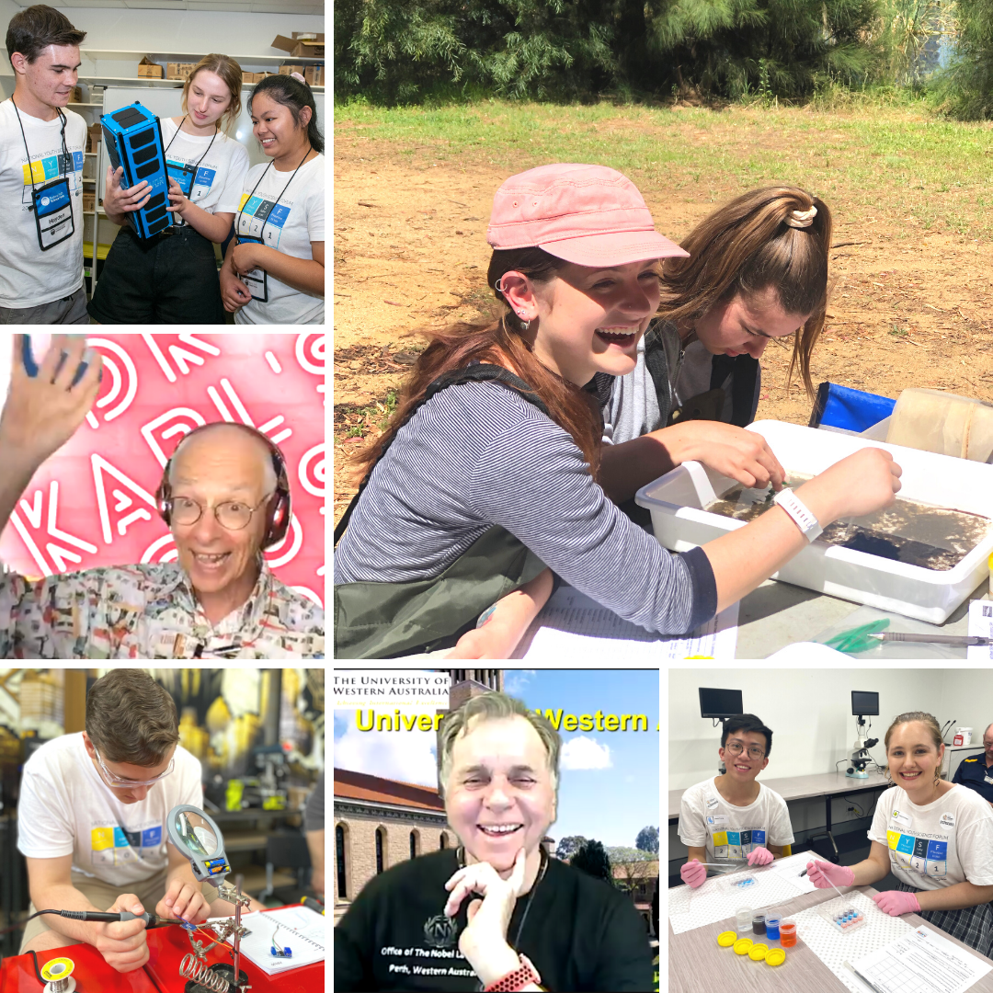

2022 NYSF Year 12 Program

Slide 3
Insert your name here
NYSF 2021
Your Rotary District Number
Your NYSF Interest Group Name
Notes:
First slide!
Add your name, rotary district number, interest group name & any further details that are appropriate depending on who the presentation is for (Rotary Club or School presentation?)

Slide 4
What is the National Youth Science Forum (NYSF)?
NYSF is a non-profit charity that runs a number of science outreach activities.
Its flagship NYSF Year 12 Program runs in January each year
The program is a youth-led program for students interested in Science, Technology, Engineering and Maths (STEM)
Participants get a taste of the wide variety of study and career opportunities available across all STEM fields
Insert Photo of you at NYSF
Notes:
Start of by reviewing the basics of the organisation and what the National Youth Science Forum is, as per the slide.

Slide 5
What is the National Youth Science Forum (NYSF)?
The NYSF Year 12 program has been running since 1984
NYSF was initiated by Rotary, and clubs in our communities continue their close involvement today
More than 13,000 participants have attended over 38 years from all over Australia.
The program is funded by government, corporate and university partners
During the Program students participate in a combination of online and in-person STEM visits, lectures, workshops, Career’s days and social activities.
Notes:
NYSF was established in 1983 with the first program running in 1984. Above are some of the more interesting points about the history of the organisation to let everyone know about.

Slide 6
What happens at the NYSF Year 12 Program?
Add some of your best photos for the different parts of session. This part could include 3-4 slides
Here you can talk about:
Nobel Laureate lectures
Critical thinking workshop
Science@Home
Live Cross to CERN and Antarctica
Specialist Lectures
STEM communication panel
Career’s Day
Social Events
STEM Visits (Digital or In-person)
Notes:
Rotarians want to hear about the opportunities their club has provided to you while younger school students want to hear about the experience they might be able to apply for in the future. Remember a key part about NYSF is that so much of the experience is a surprise for incoming students, so be particularly conscious that your audience may contain future NYSF attendees and don’t give too much away!
Here you can talk about:
Laboratory and site visits
Keynote addresses and lectures
Workshops, debates and forums
Science Dinner
Socialising
Networking
Experience life on campus at uni

Slide 7
January 2021 highlights
182 Speakers (online)
Prof Brian Schmidt
Prof Barry Marshall
Dr Karl
14 Days of STEM
ANSTO
Taronga Zoo
Questacon
57 In-person visits
The University of Queensland
Science@home (x3)
SciComm (x2)
Dr Karl’s House Party
Prof Lisa Harvey-Smith
Australian Antarctic Division
CERN
Armidale
The University of Newcastle
Adelaide
University of Western Australia
Curtin University
Griffith University
University of Tasmania
The Australian National University
University of Canberra
Including…
Including…
Including…

Slide 8
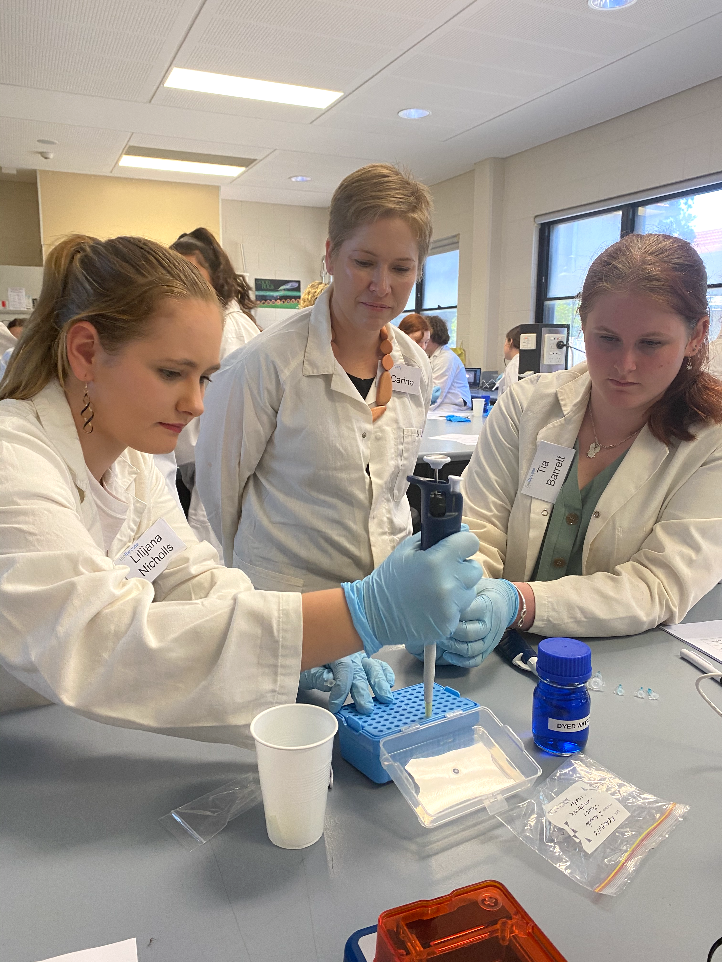
Who can attend the NYSF Year 12 Program?
Students who:
Are currently in year 11 and will move on to year 12 next year
Are interested in science, technology, engineering and mathematics
Are involved in community and extracurricular activities
Students apply and then go through a selection process delivered by Rotary volunteers from the 18 Rotary districts
Students from across Australia, including those in rural and regional areas, are very welcome to apply
Equity scholarships are available for those who may need some support with the fees
Notes:
Now that you’ve talked about what happens at the NYSF, you can start talking about who can attend, for students who might now be interested. The key points you will need to mention are all on the slide.

Slide 9
How to apply for the NYSF Year 12 Program?
Applications are taken online through the NYSF database – www.nysf.edu.au. All information you need is here, including fee information
Applications open early April and close at the end of June
Do your research early to find a Rotary club in your area to endorse you.
Some Rotary clubs may provide some financial assistance, but this will vary from club to club and needs to be discussed with your club. Families are also welcome to self-fund their NYSF experience.
Notes:
Now that the students know what happens at NYSF and who can apply, you can start telling them more specifically about how to apply.
If you have any stories about district selections or any pro tips for students applying – now is the time to tell them!

Slide 10
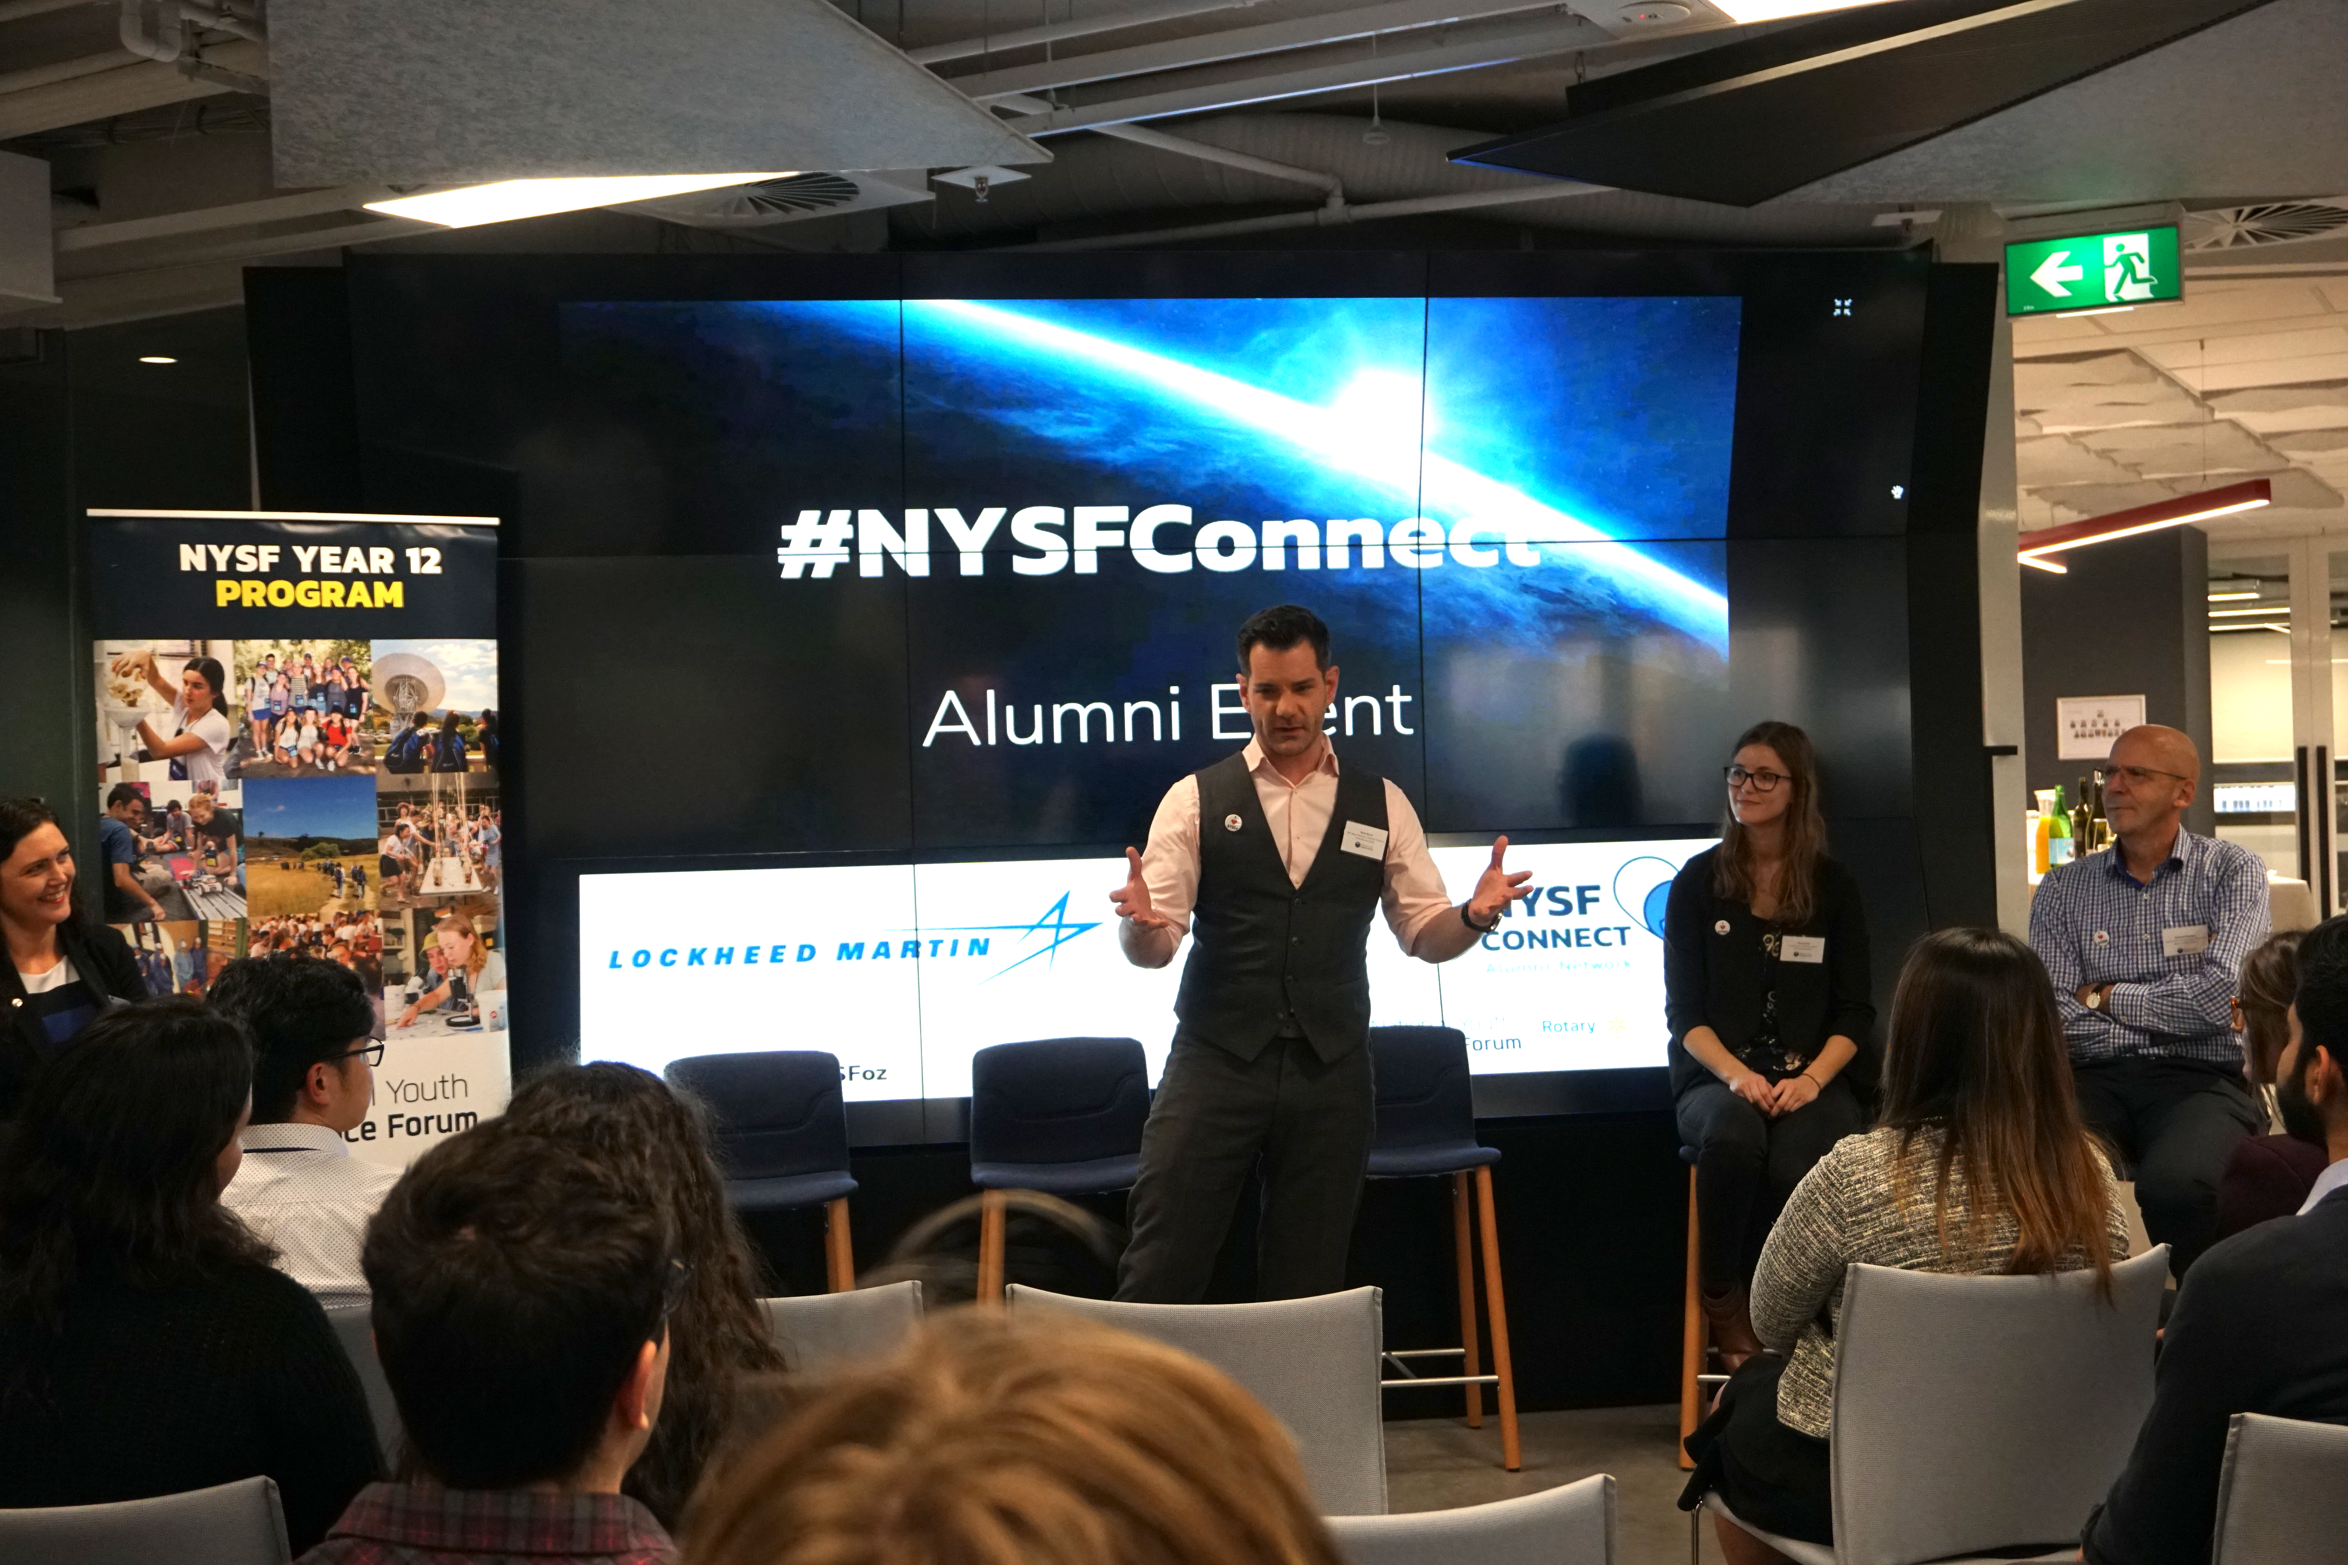
After the NYSF Year 12 Program?
After completing the NYSF Year 12 Program you become part of our 13,000+ NYSF alumni network. You will have the opportunity to participate in activities via our NYSF Connect alumni program.
In 2021, NYSF hosted 30 webinars with 41 guests across all ranges of STEM. This year’s guests included the immediate past and present Australia’s Chief Scientist!
NYSF Connect university visits are primarily held during school holidays in the same year following the NYSF Year 12 Program
Other networking and professional development events are held throughout the year via our webinar series or in-person events
Notes:
The main opportunities available to NYSF participants, following the initial January program is the NYSF Connect Events
It’s important to explain here that each Connect event is held at a different time so that students have the option to attend all of them if they want. Attendance is optional though so students can also just pick the Connect location that is relevant to where they are interested in going. But it also lets them look at other universities and gain more information about options.

Slide 11
Thank You
If you are doing a presentation to YOUR school or Rotary Club please make sure you thank them directly and identify any individuals who may have helped you
If anyone provided some funding for you to attend, please mention them
It’s also important to acknowledge all of the NYSF Partners – see next slide.
Indicate how people can find out more from you – can they contact you?
Notes:
Anyone and everyone who was responsible for helping you to attend the NYSF should have the opportunity to hear about your experience on your return and also to receive a thank you.

Slide 12

Notes:
These are all the corporate and university partners that supported the program in 2019. You should show this slide for a short moment, there is no need to name each individual partner.

Slide 13
Applications open early April
www.nysf.edu.au

