Slide 1

National Youth Science Forum
Template presentation
This template is designed to make your presentations about the NYSF a little bit easier.
Please use these slides as a base and add your own photos, stories & comments as you go!
Ensure you read the notes sections of each slide for more ideas. (Delete this slide before you make your presentation!)

Slide 2
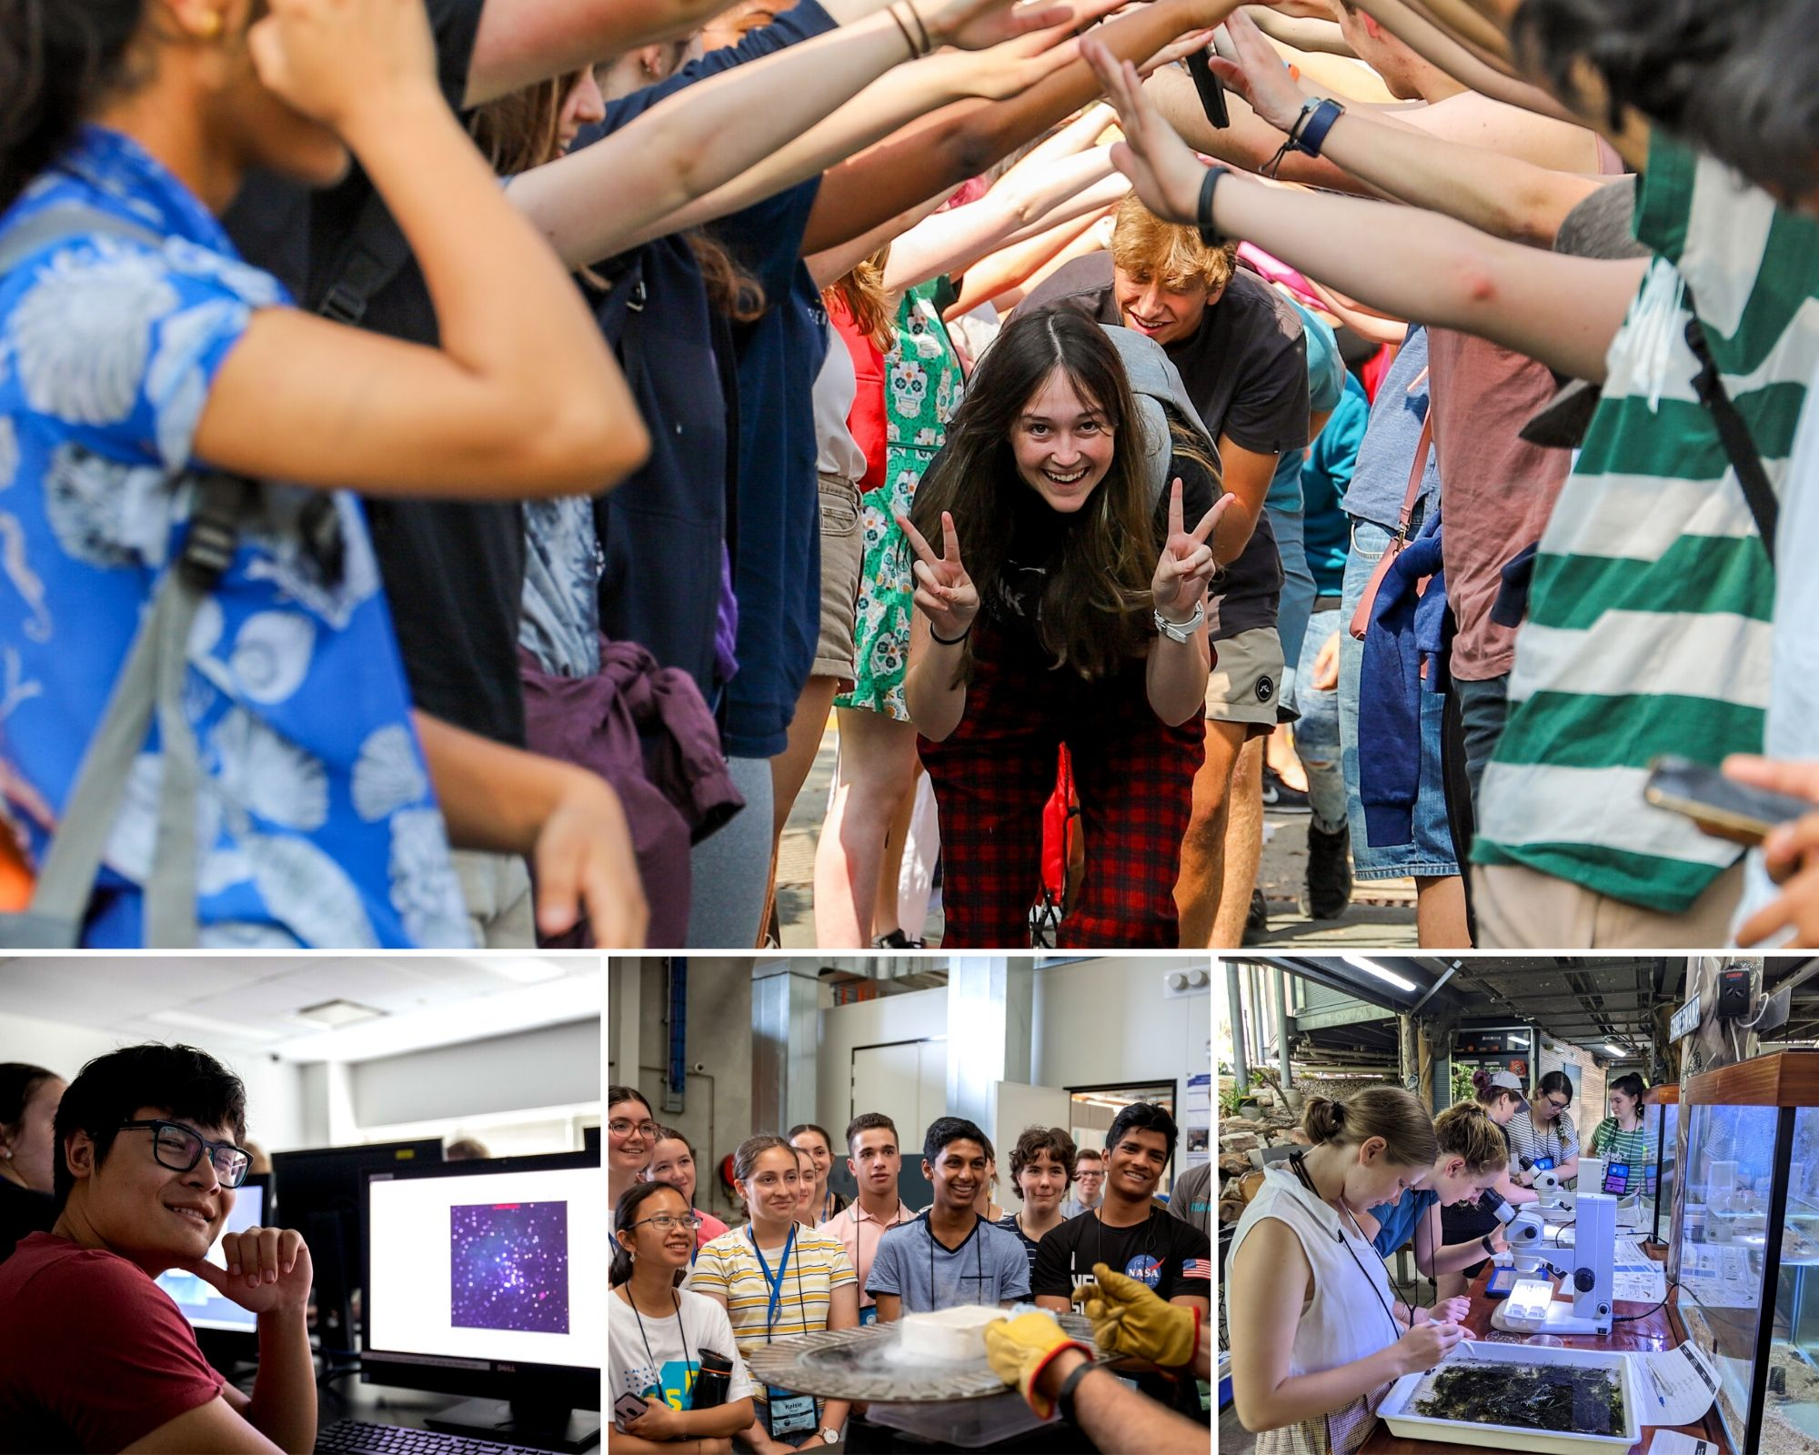

NYSF 2021
Year 12 Program

Slide 3
Insert your name here
Your Rotary District Number
Notes:
First slide!
Add your name, rotary district number, interest group name & any further details that are appropriate depending on who the presentation is for (Rotary Club or School presentation?)

Slide 4
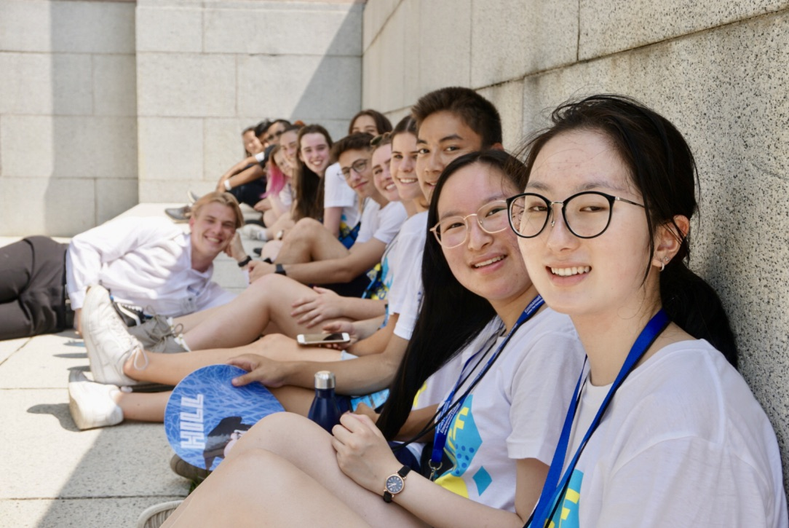
What is the National Youth
Science Forum (NYSF)?
NYSF is a non-profit organisation that runs a number of science outreach activities. Its flagship NYSF Year 12 Program runs in January each year
The program is a 10-day residential activity for students interested in Science, Technology, Engineering and Maths (STEM)
Participants gain significant insights into the variety of study and career opportunities available across STEM fields
Notes:
Start of by reviewing the basics of the organisation and what the National Youth Science Forum is, as per the slide.

Slide 5
What is the National Youth
Science Forum (NYSF)?
The NYSF Year 12 program has been running since 1984
NYSF was initiated by Rotary, and clubs in our communities continue their close involvement today
More than 12,000 participants have attended over 36 years
The program is funded by government, corporate and university partners
NYSF Year 12 Program participants stay on campus at the host university
Notes:
NYSF was established in 1983 with the first program running in 1984. Above are some of the more interesting points about the history of the organisation to let everyone know about.

Slide 6
What happens at the NYSF Year 12 Program?
Notes:
Rotarians want to hear about the opportunities their club has provided to you while younger school students want to hear about the experience they might be able to apply for in the future. Remember a key part about NYSF is that so much of the experience is a surprise for incoming students, so be particularly conscious that your audience may contain future NYSF attendees and don’t give too much away!
Here you can talk about:
Laboratory and site visits
Keynote addresses and lectures
Workshops, debates and forums
Science Dinner
Socialising
Networking
Experience life on campus at uni

Slide 7
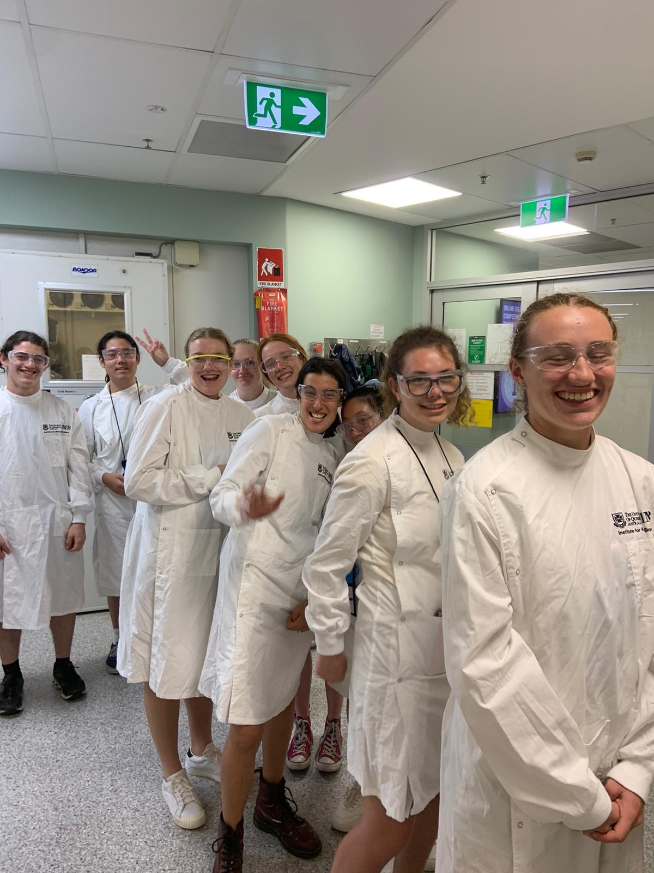
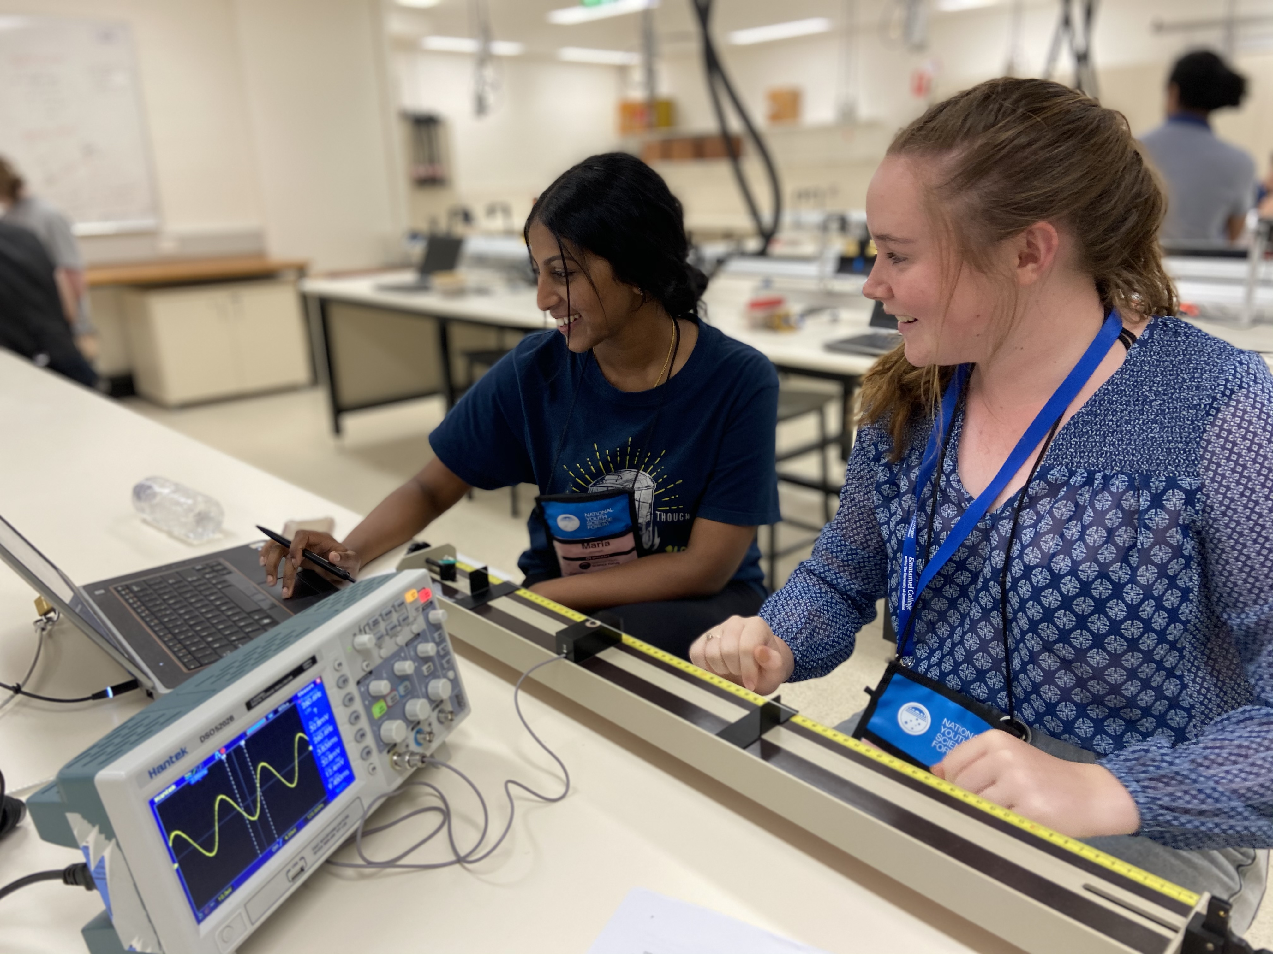
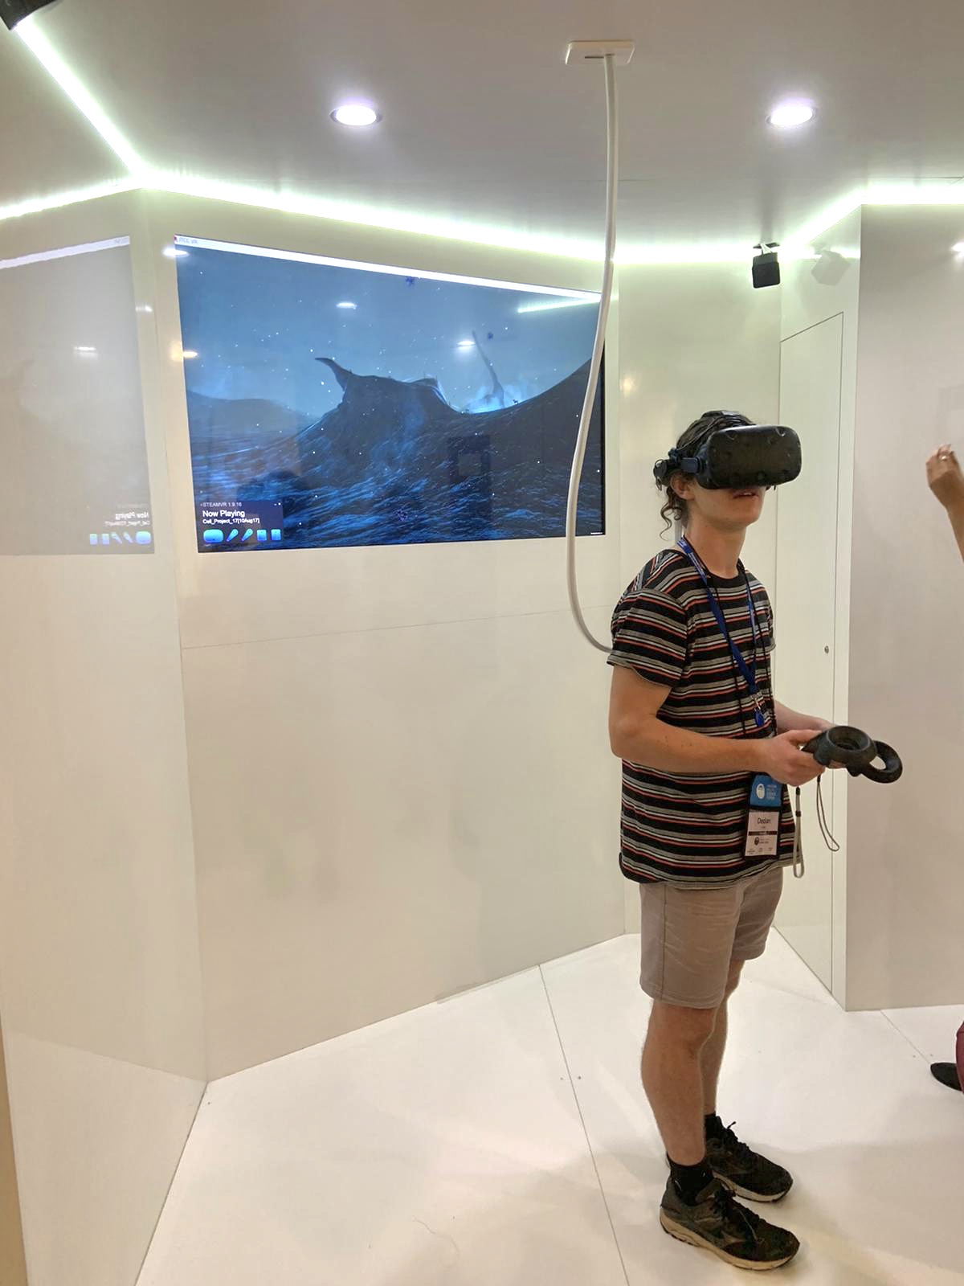
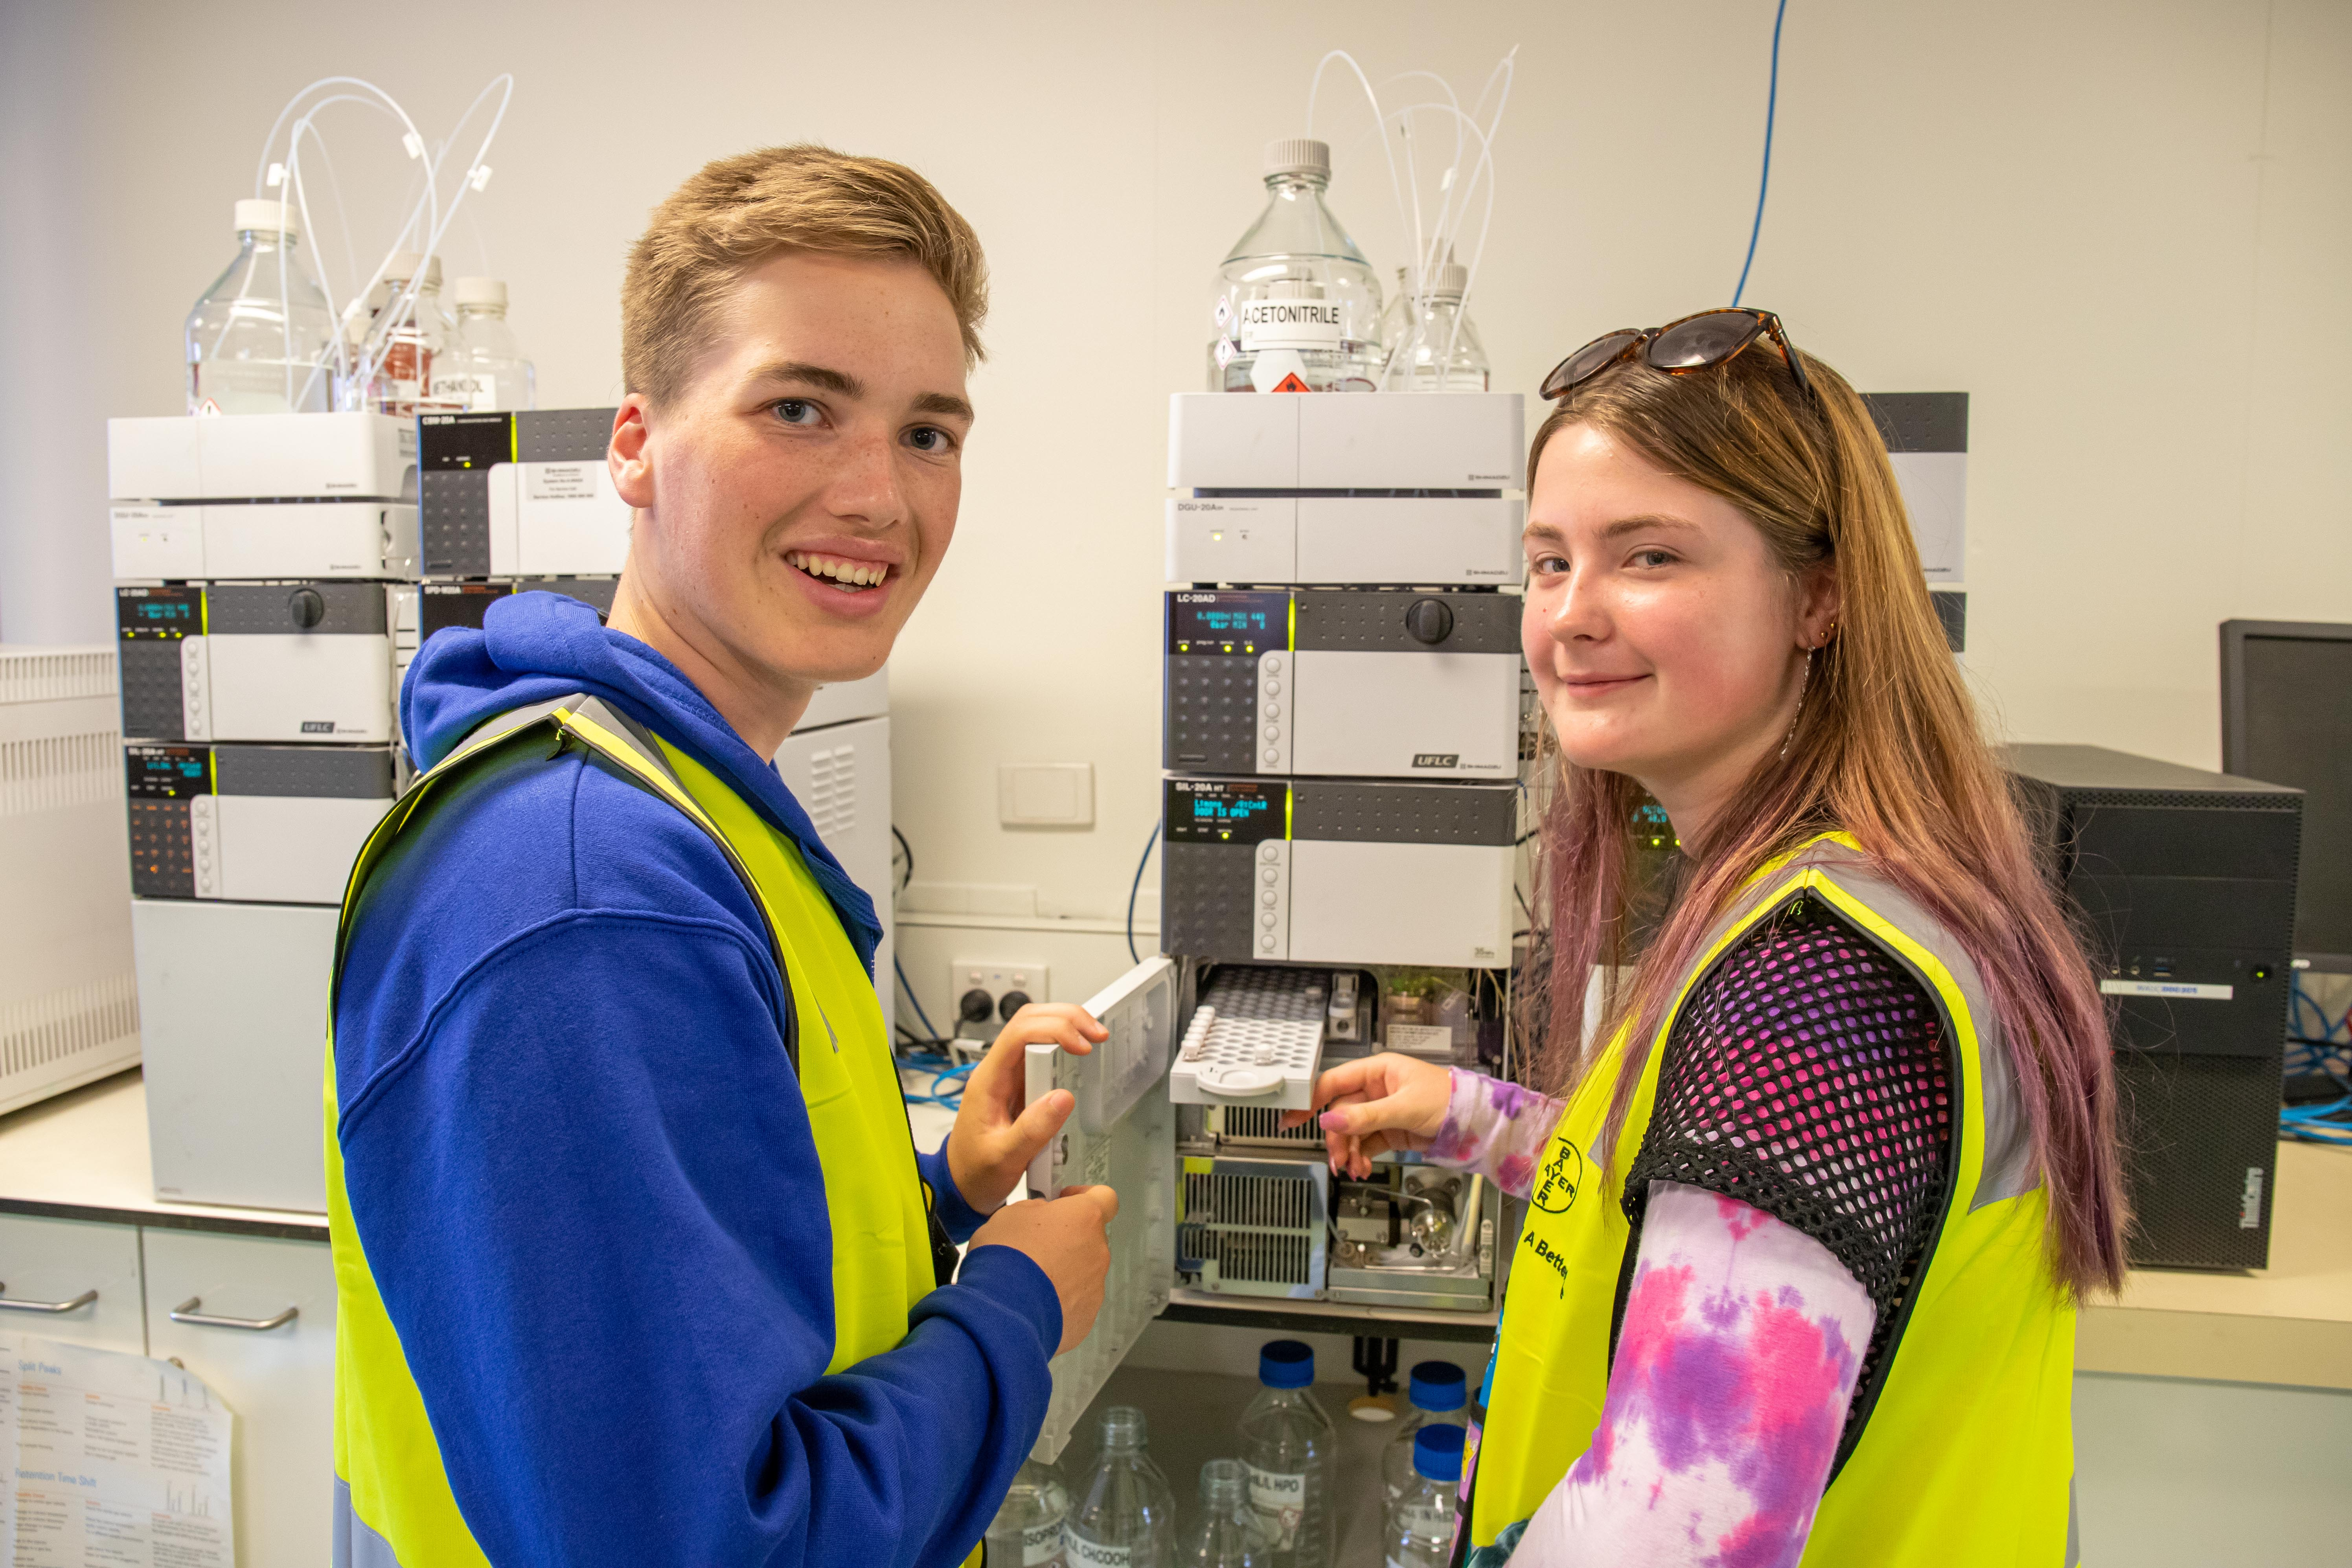
Laboratory and Site Visits
Notes:
Participants attend a range of laboratory and site visits across all STEM areas. The gain behind the scenes access to many world class institutions and get an idea of working as a scientist after study!

Slide 8

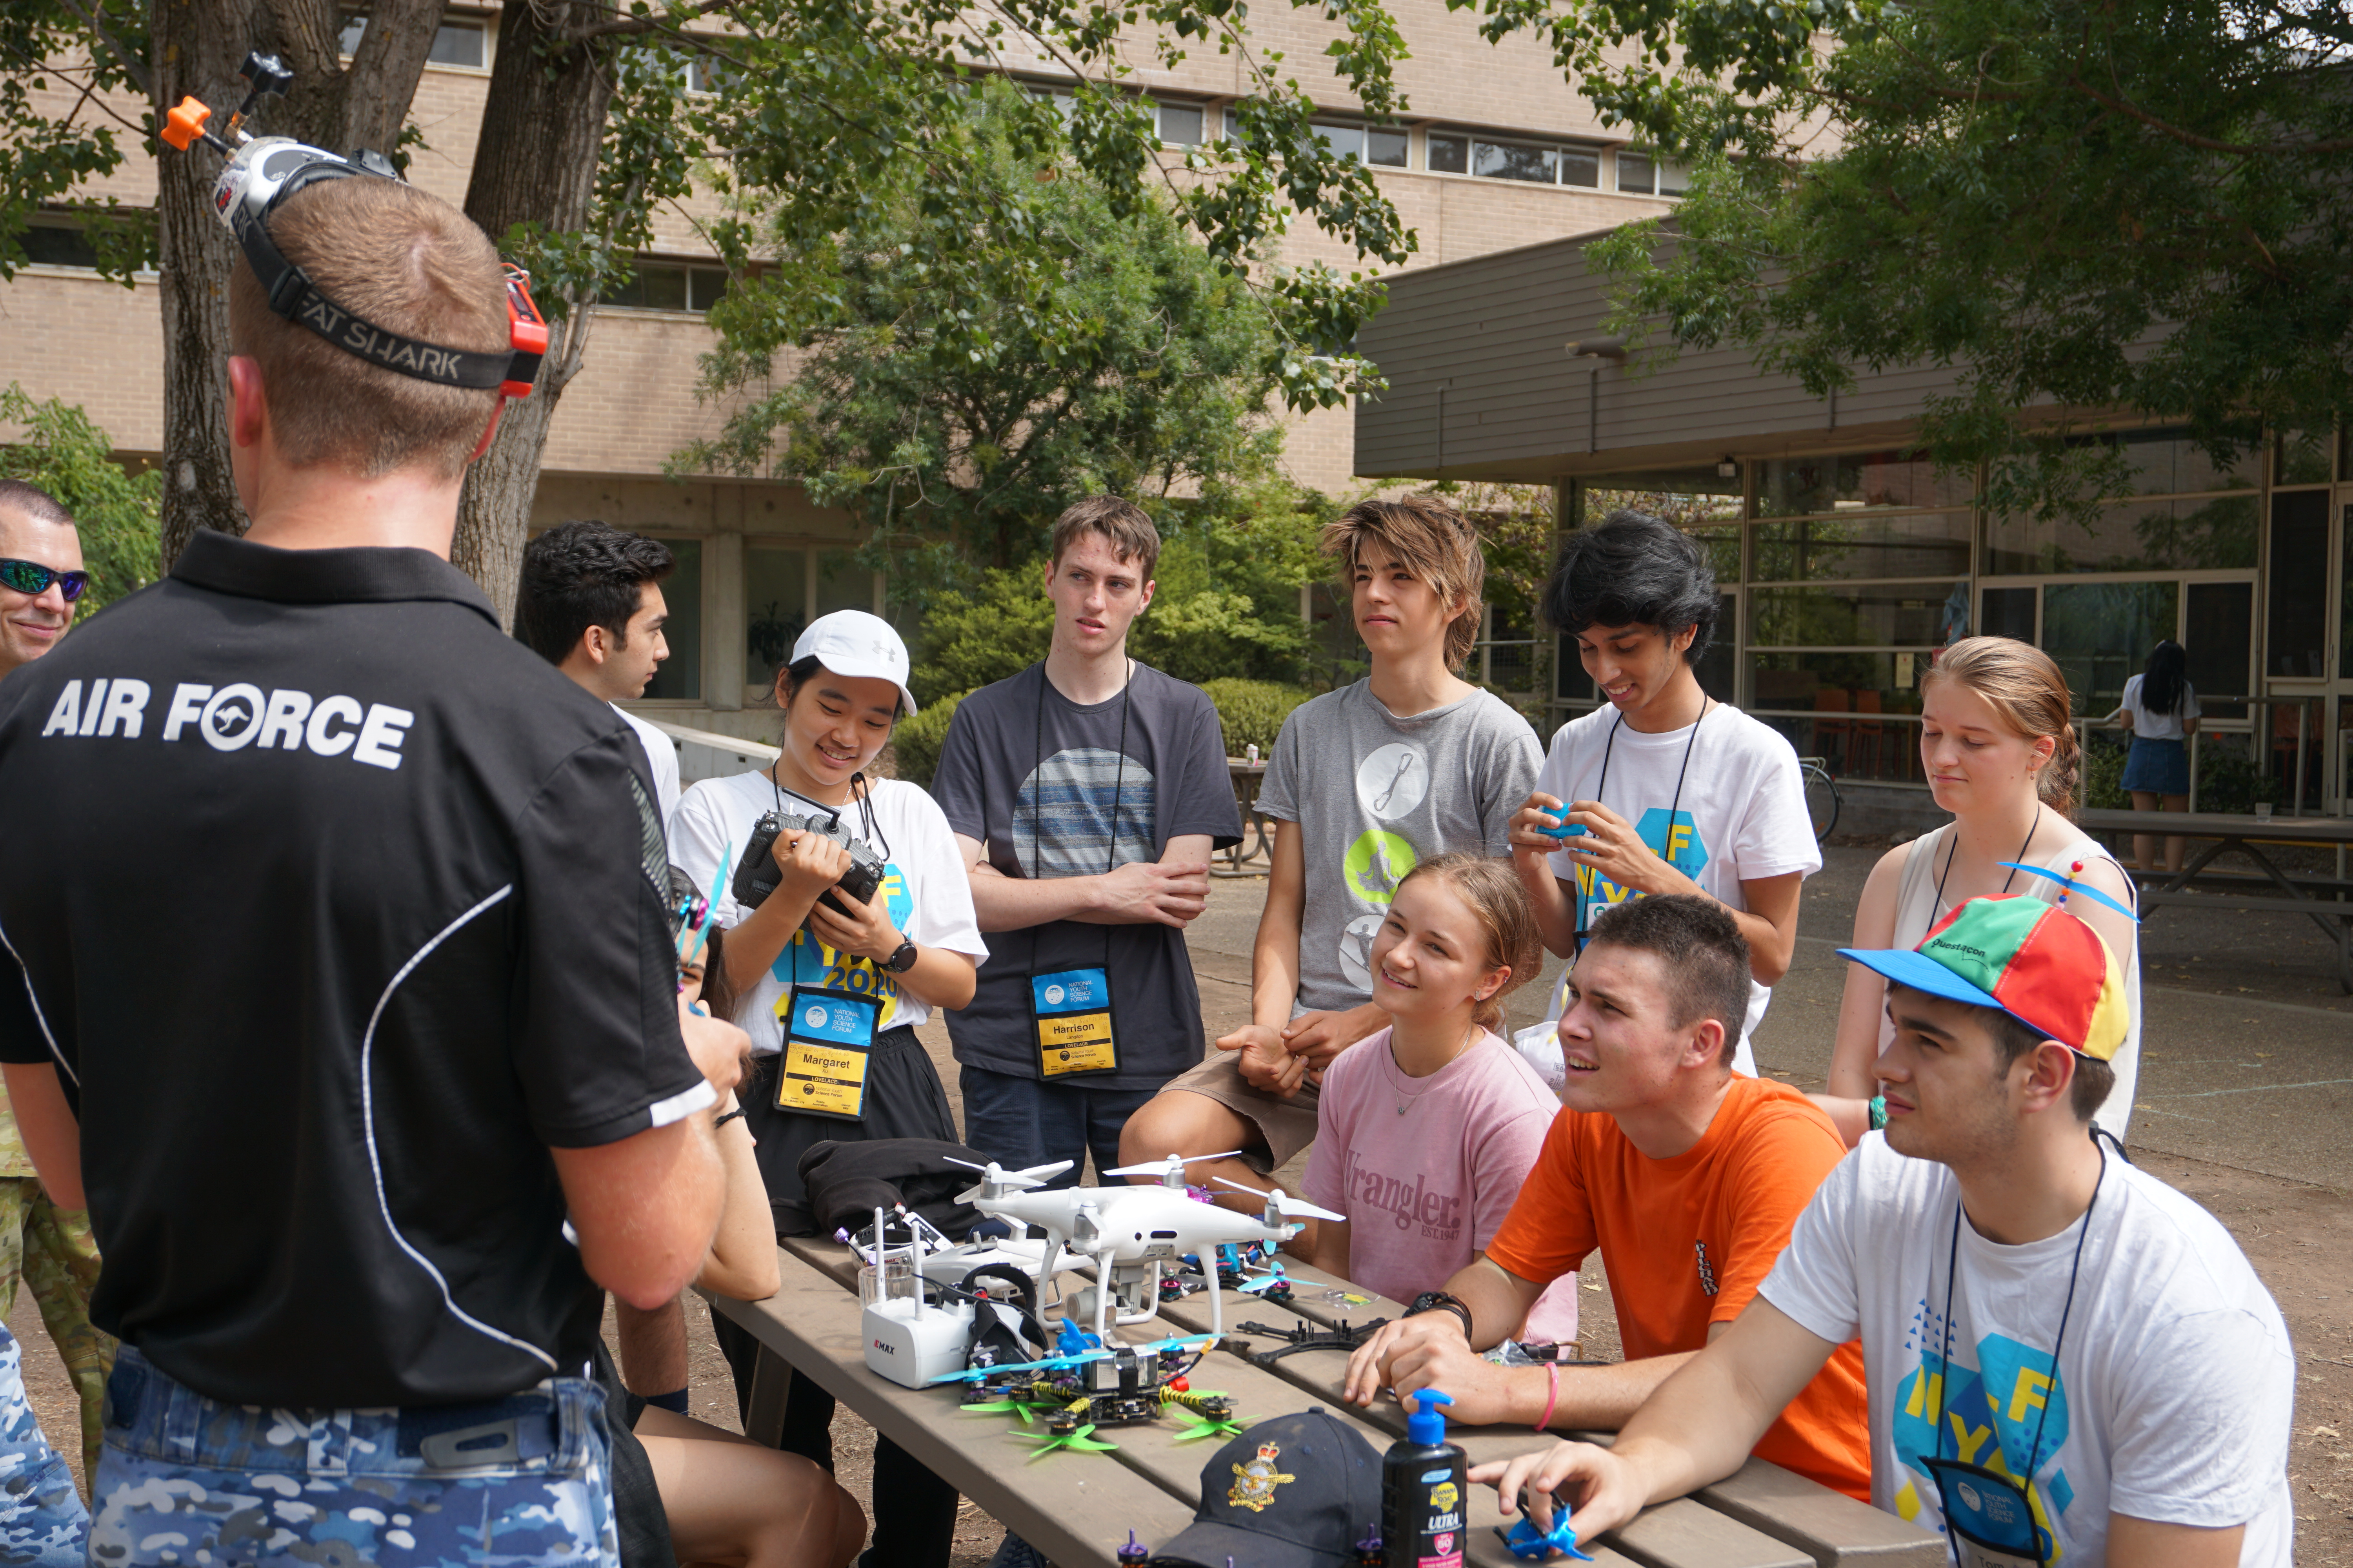
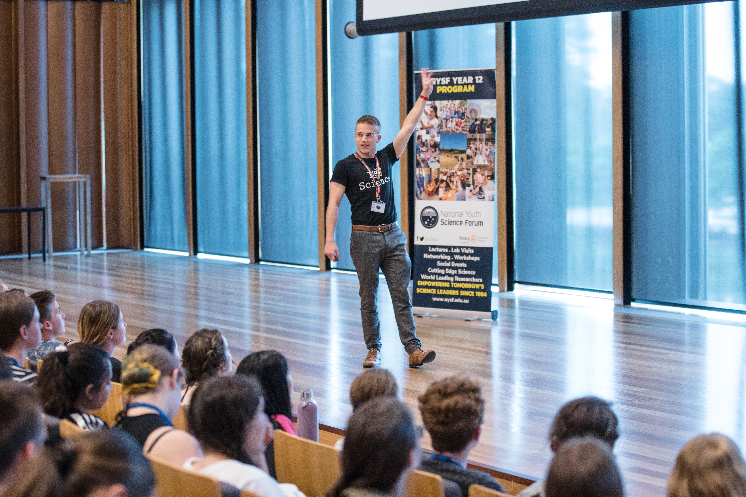
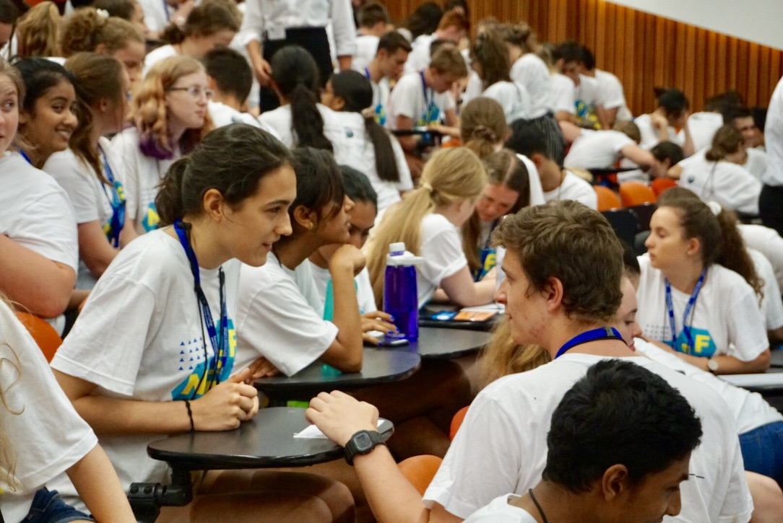
Lectures and Workshops
Notes:
NYSF students hear from a range of lecturers who specialize in their field of expertise and learn about the boundless careers paths they could take.

Slide 9
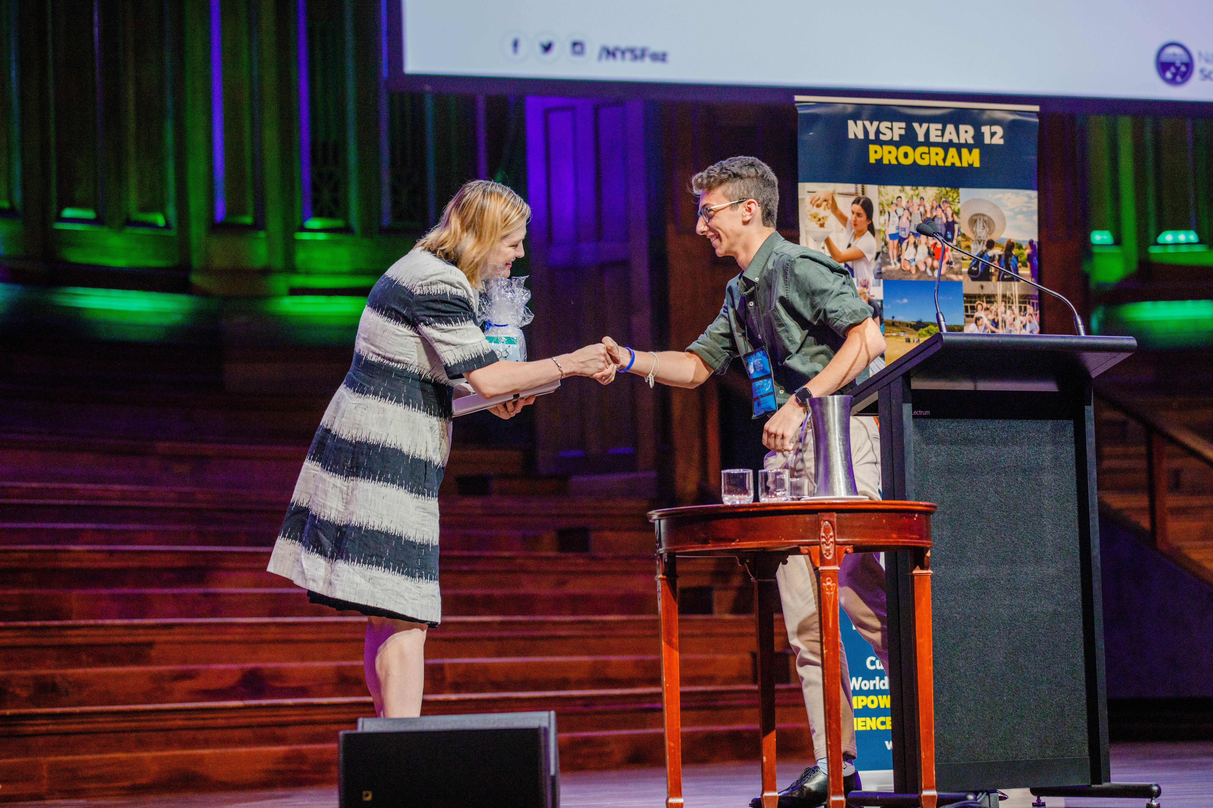
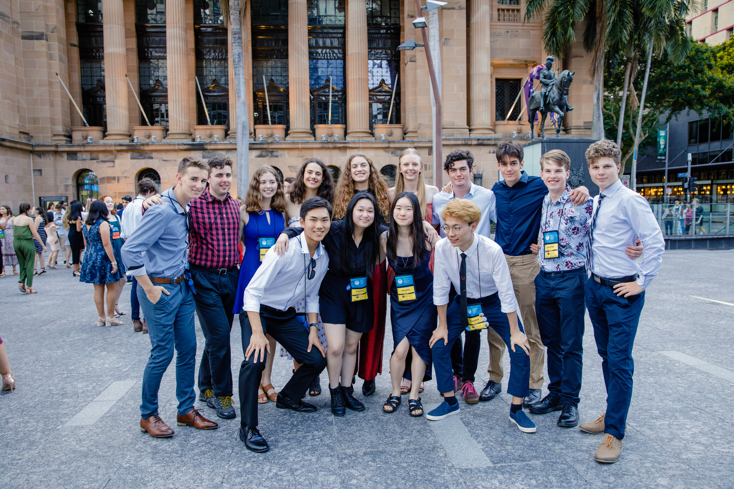
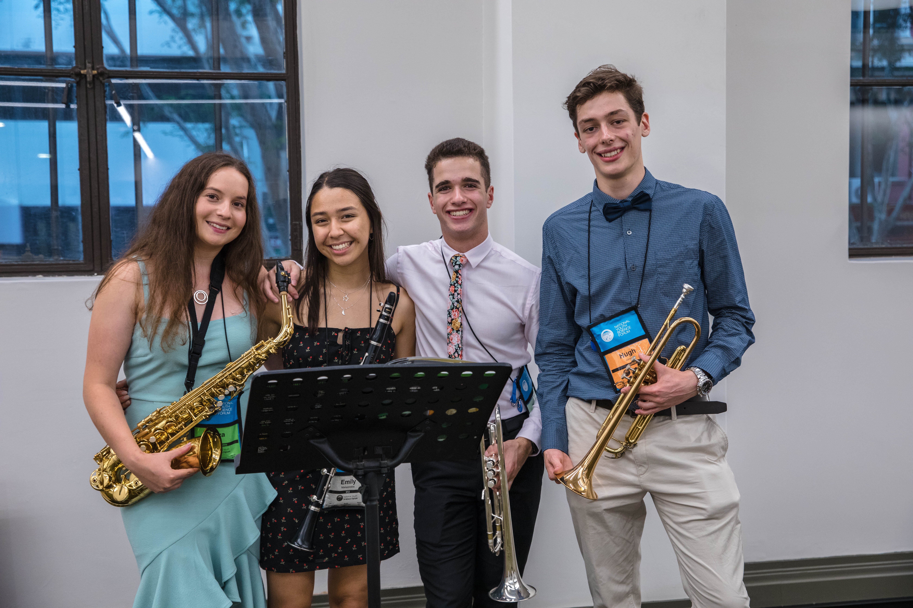
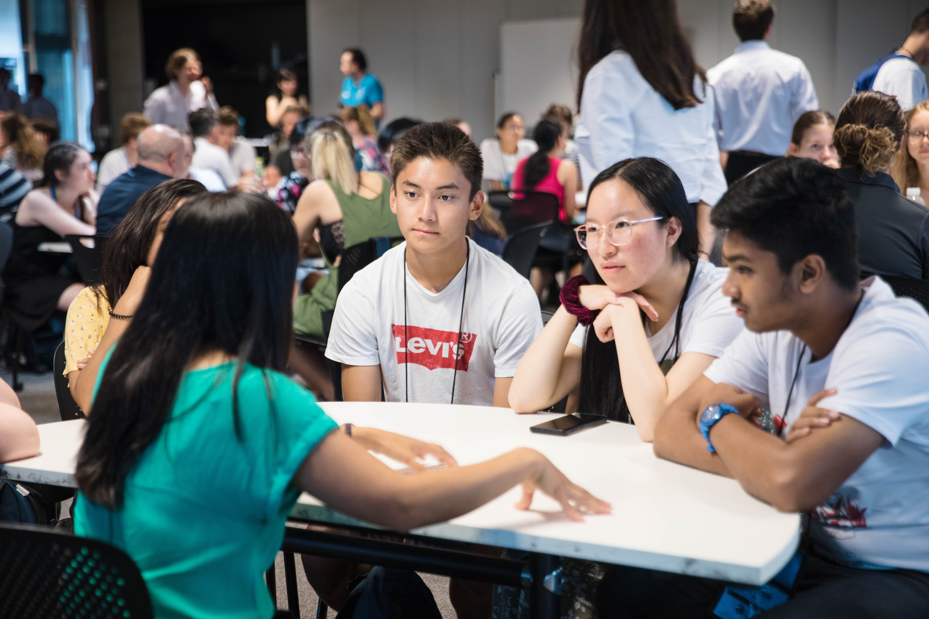
Partners Day & Science Dinner
Notes:
Towards the end of the program Participants hear from the Partners of NSYF, the organizations that support their program! Students hear from a range of partners that could be part of their future, whether it be study, internships, volunteering or future employment. Through the speed meet, students can ask questions to industry professionals before collecting a range of resources in the expo. To finish off the day, participants freshen up for the Science Dinner where they can continue to be inspired as they share a table with STEM professionals and hear from a key-note speaker, a leader in Australian STEM.

Slide 10
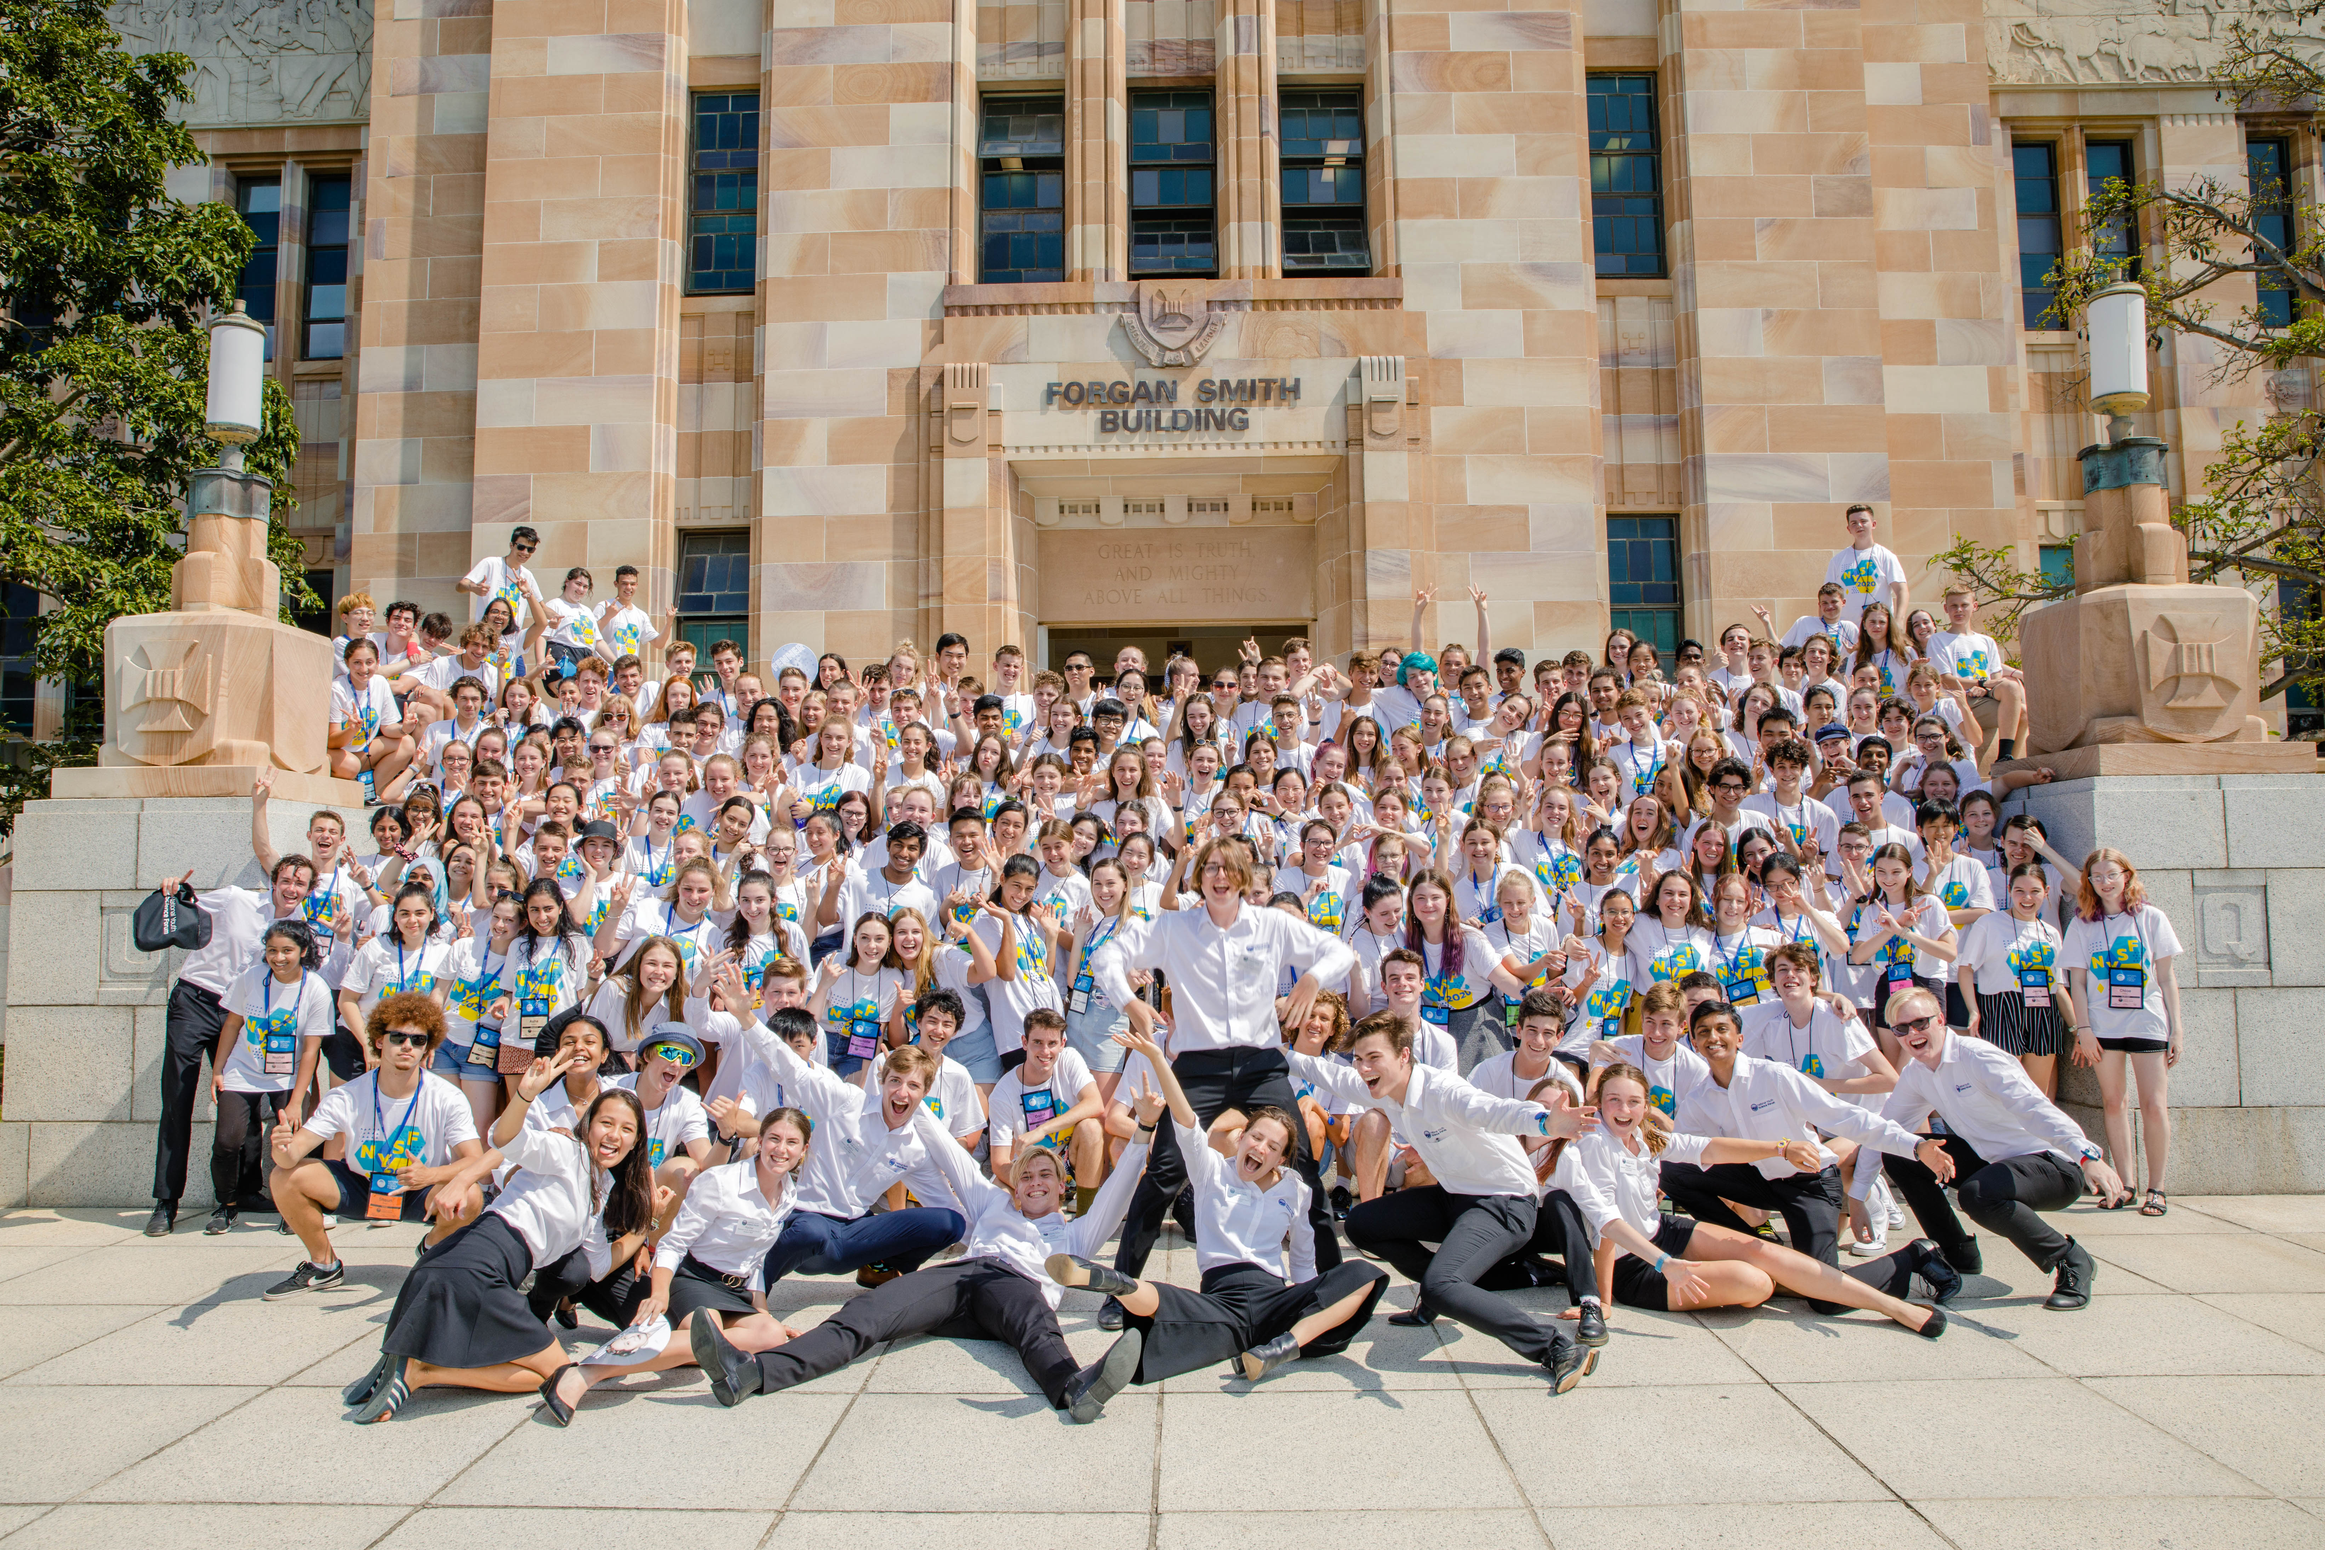
Socialising and FUN!

Slide 11
Who can attend the NYSF Year 12 Program?
Students who:
Are currently in year 11 and will move on to year 12 next year
Are interested in science, technology, engineering and maths (STEM)
Are involved in community and extracurricular activities
Anyone from all over Australia can apply
Notes:
Now that you’ve talked about what happens at the NYSF, you can start talking about who can attend, for students who might now be interested. The key points you will need to mention are all on the slide.

Slide 12
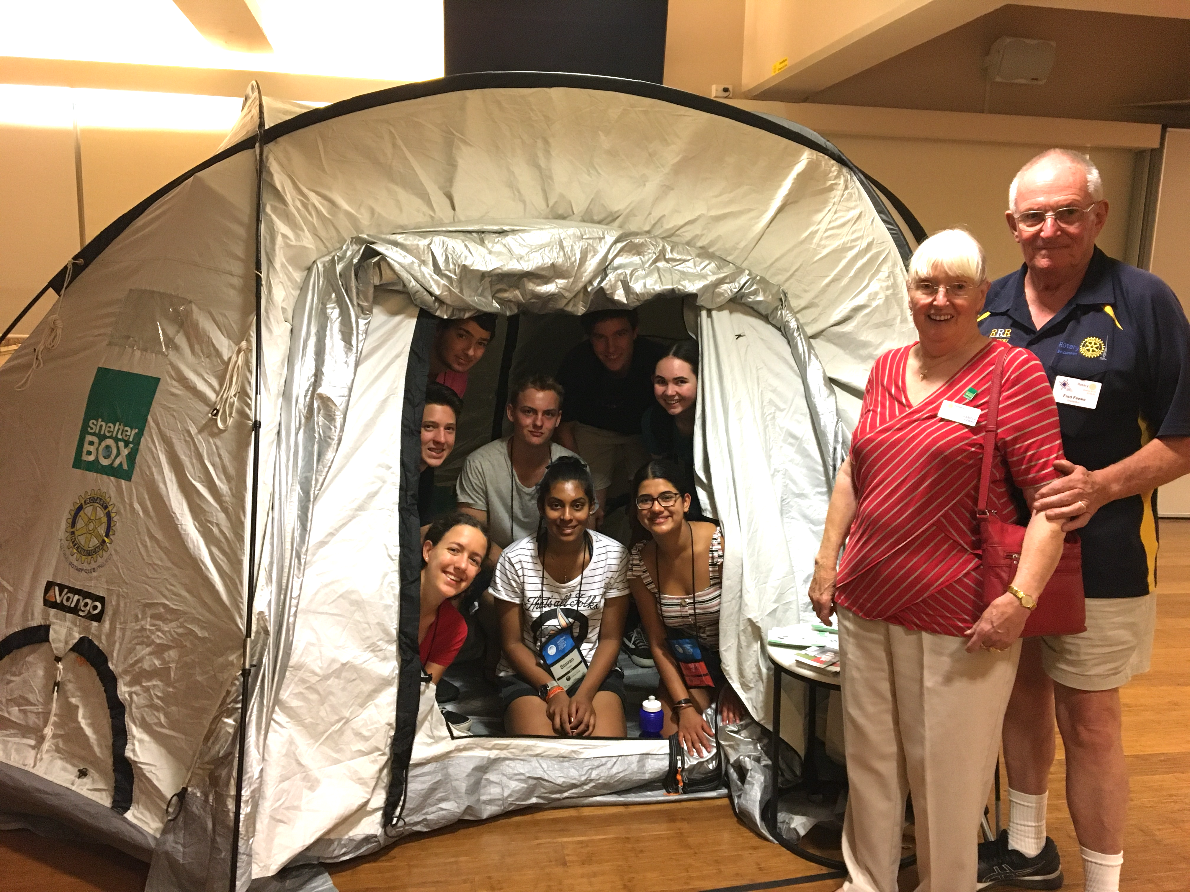
Who can attend the NYSF Year 12 Program?
In 2021, there are places for nearly 600 students in three sessions, selected through the 21 Rotary districts.
Regional quotas for each Rotary district ensuring equity of access for students from remote and regional areas.
Notes:
And here are three more key points to mention from the slide.

Slide 13
How to apply for the NYSF Year 12 Program
Applications are taken online through the NYSF database – www.nysf.edu.au. All information you need is here, including fee information
Applications open early March and close 20 July each year
An application will need to be endorsed by a local Rotary club, students may be starting to contact you!
If a club endorses a student, their application is forwarded for selection to represent your Rotary District
Notes:
Now that the students know what happens at NYSF and who can apply, you can start telling them more specifically about how to apply.
If you have any stories about district selections or any pro tips for students applying – now is the time to tell them!

Slide 14
After the NYSF Year 12 Program
NYSF Connect Events
Connect Events are primarily held during school holidays in the same year following the NYSF Year 12 Program
Students can visit different universities to where they stayed in January
Visits are also on offer to corporate and other partners who will host site tours
Notes:
There are two main opportunities available to NYSF participants, following the initial January program.
The first of these is the NYSF Connect Events
It’s important to explain here that each Connect event is held at a different time so that students have the option to attend all of them if they want. Attendance is optional though so students can also just pick the Connect location that is relevant to where they are interested in going. But it also lets them look at other universities and gain more information about options.

Slide 15
After the NYSF Year 12 Program
International Programs
      In 2020 NYSF Alumni can apply for a place at the London International Youth Science Forum (LIYSF) London, England
                LIYSF has been running for more than 50 years and attracts over 500 students from almost 75 countries for a two-week session
Notes:
The second opportunity that is open exclusively to students who have attended the NYSF are the International Programs. You can mention the points on this slide.

Slide 16

Notes:
These are all the corporate and university partners that supported the program in 2019. You should show this slide for a short moment, there is no need to name each individual partner.

Slide 17

www.nysf.edu.au

